Slide 1
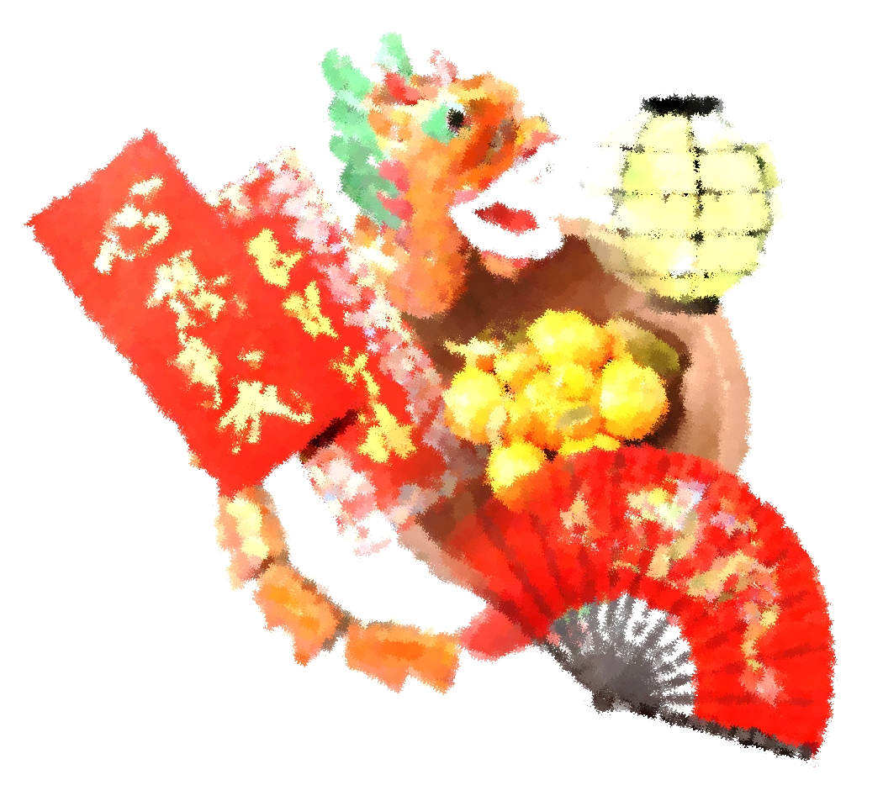
Hot Issue
The Internationalisation of Traditional Festivals and Customs

Slide 2
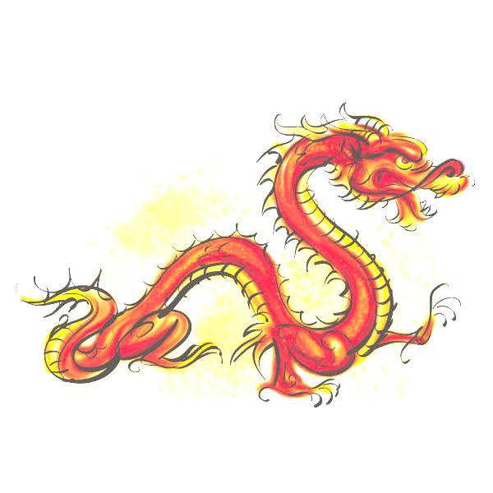
Introduction
Due to the growing number of overseas Chinese around the world, Chinese traditional festivals and customs have also been introduced to every corner of the world. Apparently, Chinese customs and traditions are widely recognized and respected in the West. For instance, there are lots of activities celebrating the Lunar New Year in New York State and Maryland. Since 2001, an annual lighting ceremony for the Chinese Lunar New Year has been held at the Empire State Building in New York City so as to show respect to Chinese traditional festivals and customs.
On the other hand, Western festivals have also gained growing popularity in the Chinese society. Many Chinese citizens have begun celebrating Western festivals such as Christmas and Valentine’s Day with an enthusiasm that is shared by their Western counterparts. Each year around Christmas and Valentine’s Day, shopping malls are beautifully decorated and stores actively promote their products in the name of these Western festivals.
Seeing that more Americans celebrate Chinese Lunar New Year while more Chinese people celebrate Christmas, some people consider that traditional festivals and customs, under the influence of globalization, are no longer owned solely by a single ethnic group. In terms of inheritance and continuity of Chinese traditional festivals and customs, what are the challenges and opportunities brought by the internationalisation of traditional festivals?

Slide 3

Questions for Enquiry
1. Apart from the growing number of overseas Chinese around the world, what are the major factors that make Chinese traditional festivals more and more important and popular in the West?
2. “Traditional festivals have become more internationalised.” Do you agree with this statement? Why or why not?
3. Does globalization bring challenges or opportunities for the inheritance and continuity of Chinese traditional festivals and customs? Why?

Slide 4
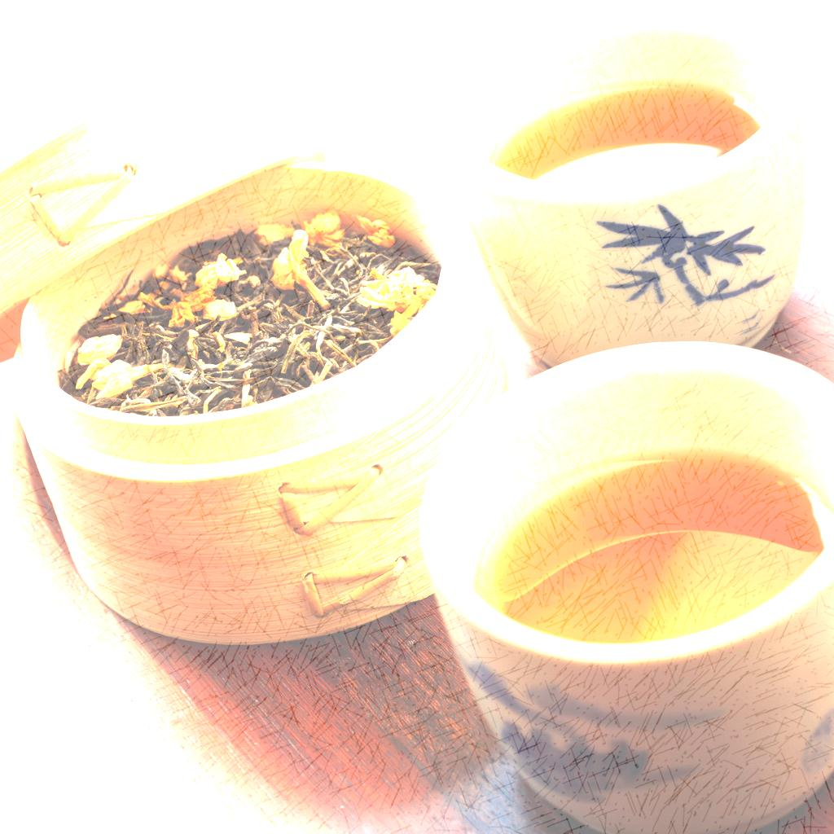
Background Information
大公報(2014年1月25日)〈年味就是人情味〉(取自: http://news.takungpao.com/paper/q/2014/0125/2241308.html)
People's Daily Online (24 January 2014) “Top 5 Spring Festival customs in China”. Please access: http://english.peopledaily.com.cn/90782/8521202.html
Background Information
Question for Enquiry (1)
Question for Enquiry (2)
Question for Enquiry (3)

Slide 5
1. Apart from the growing number of overseas Chinese around the world, what are the major factors that make Chinese traditional festivals more and more important and popular in the West?
大公報(2014年1月25日)〈中國人過節 全世界賺錢〉(取自: http://news.takungpao.com/paper/q/2014/0125/2241372.html)
大公報(2014年2月4日)〈紅包在西方〉(取自: http://news.takungpao.com.hk/paper/q/2014/0204/2256861.html)
太陽報(2014年2月2日)〈新年外遊成熱潮 有人歡喜有人愁〉(取自: http://the-sun.on.cc/cnt/china_world/20140202/00431_001.html)
文匯報(2014年1月30日)〈中國影響力增 讓春節在世界流行〉(取自: http://paper.wenweipo.com/2014/01/30/YO1401300003.htm)
＞More information
Background Information
Question for Enquiry (1)
Question for Enquiry (2)
Question for Enquiry (3)

Slide 6
1. Apart from the growing number of overseas Chinese around the world, what are the major factors that make Chinese traditional festivals more and more important and popular in the West?
成報(2013年2月26日) 〈全世界都在過中國年 春節漸成國際節日〉 (取自: http://www.hkcna.hk/content/2013/0226/180788.shtml)
環球時報(2014年1月29日)〈中國影響力讓春節流行 世界各地加入慶祝行列〉(取自: http://big5.xinhuanet.com/gate/big5/news.xinhuanet.com/ziliao/2014-01/29/c_126077592.htm)
Xinhua News (13 February 2011) “Where West meets East: American families with children adopted from China”. Please access: http://news.xinhuanet.com/english2010/indepth/2011-02/13/c_13730015.htm
Background Information
Question for Enquiry (1)
Question for Enquiry (2)
Question for Enquiry (3)

Slide 7
2. “Traditional festivals have become more internationalised.” Do you agree with this statement? Why or why not?
人民網(2014年2月4日)〈中國春節日益傳統化、全球化〉(取自: http://big5.xinhuanet.com/gate/big5/news.xinhuanet.com/world/2014-02/04/c_126088362.htm)
大公報(2013年12月28日)〈熱鬧的「中式聖誕」〉(取自: http://news.takungpao.com/paper/q/2013/1228/2137544.html)
大公報(2014年2月5日)〈中國式放假〉(取自: http://news.takungpao.com.hk/paper/q/2014/0205/2257620.html)
干春松(2008)。傳統習俗及節日在現代中國社會的意義、發展和挑戰。取自: http://ls.edb.hkedcity.net/LSCms/file/web_v2/prof_dev/online_course/modern_china_ches/event8/event_08_speech.pdf
＞More information
Background Information
Question for Enquiry (1)
Question for Enquiry (2)
Question for Enquiry (3)

Slide 8
2. “Traditional festivals have become more internationalised.” Do you agree with this statement? Why or why not?
成報(2013年4月4日)〈東風西漸華人習俗過異邦〉(取自: http://www.singpao.com/zt/cwkls/201304/t20130404_427613.html)
明報(2014年2月1日)〈各國喜迎農曆新年〉(取自: http://news.sina.com.hk/news/20140201/-12-3179142/1.html)
香港商報(2013年9月12日)〈世界之窗中西合璧度中秋〉(取自: http://www.hkcd.com.hk/content/2013-09/12/content_3245407.htm)
香港商報(2013年12月25日)〈中國新聞簡訊〉(取自: http://www.hkcd.com.hk/content/2013-12/25/content_3286594.htm)
＞More information
Background Information
Question for Enquiry (1)
Question for Enquiry (2)
Question for Enquiry (3)

Slide 9
2. “Traditional festivals have become more internationalised.” Do you agree with this statement? Why or why not?
晴報(2014年2月5日)〈香港節慶〉(取自: http://www.skypost.hk/column/%E8%8E%8A%E5%81%89%E8%8C%B5/007010001019/%E9%A6%99%E6%B8%AF%E7%AF%80%E6%85%B6/126677)
新華網(2014年2月3日)〈日媒：中國春節日益傳統化全球化〉(取自: http://big5.xinhuanet.com/gate/big5/news.xinhuanet.com/world/2014-02/03/c_126087615.htm)
BBC英倫網(2014年1月28日)〈海外生存之惑：過年是別人的事〉(取自: http://www.bbc.co.uk/ukchina/trad/uk_life/contributions/2014/01/140128_life_overseas_chinese_new_year.shtml)
BBC英倫網(2014年1月30日)〈佳節有感：英國人與中國人如何「過年」〉(取自: http://www.bbc.co.uk/ukchina/trad/uk_life/2014/01/140130_life_lunar_ny_china_uk.shtml)
＞More information
Background Information
Question for Enquiry (1)
Question for Enquiry (2)
Question for Enquiry (3)

Slide 10
2. “Traditional festivals have become more internationalised.” Do you agree with this statement? Why or why not?
BBC英倫網(2014年2月3日)〈倫敦馬年春節慶祝活動熱鬧非凡〉(取自: http://www.bbc.co.uk/ukchina/trad/uk_life/2014/02/140203_life_london_cny_update.shtml)
Barbara Orel (2009), “The Internationalization Process: A Challenge to National Festivals”. Please access: http://www.pozorje.org.rs/2009/simposium/s-BarbaraOrel.pdf
Roy Eun Seok Park (2010). Duanwu Festival: National Heritage and Cultural Ownership in East Asia. Please access: http://www.stanford.edu/group/sjeaa/journal102/10-2_10%20Korea-Park.pdf
SCMP (24 January 2014) “Supermarket adds modern touch to Lunar New Year campaign”. Please access: http://www.scmp.com/news/hong-kong/article/1412388/supermarket-adds-modern-touch-lunar-new-year-campaign
＞More information
Background Information
Question for Enquiry (1)
Question for Enquiry (2)
Question for Enquiry (3)

Slide 11
2. “Traditional festivals have become more internationalised.” Do you agree with this statement? Why or why not?
The Economist (5 February 2014) “Japan's early new year: Odd man out”. Please access: http://www.economist.com/blogs/banyan/2014/02/japans-early-new-year
The Diplomat (31 January 2014) “Chinese New Year: Increasingly Traditional, Increasingly Global”. Please access: http://thediplomat.com/2014/02/chinese-new-year-increasingly-traditional-increasingly-global/
Background Information
Question for Enquiry (1)
Question for Enquiry (2)
Question for Enquiry (3)

Slide 12

3. Does globalization bring challenges or opportunities for the inheritance and continuity of Chinese traditional festivals and customs? Why?
大公報(2013年12月23日)〈葉歌:土節洋節〉(取自: http://news.takungpao.com.hk/fk/takung/small-park/2013-12/2125306.html)
大公報(2013年1月24日)〈讓子女鍾愛農曆新年〉(取自: http://news.takungpao.com.hk/paper/q/2013/0124/1403727.html)
大公報(2014年2月3日)〈過年習俗〉(取自: http://news.takungpao.com.hk/paper/q/2014/0203/2256243.html)
大公報(2014年2月6日)〈拜年新風〉(取自: http://news.takungpao.com.hk/paper/q/2014/0206/2258416.html)
＞More information
Background Information
Question for Enquiry (1)
Question for Enquiry (2)
Question for Enquiry (3)

Slide 13
3. Does globalization bring challenges or opportunities for the inheritance and continuity of Chinese traditional festivals and customs? Why?
文匯報(2012年6月22日)〈百家廊：逝去的端午節〉(取自: http://paper.wenweipo.com/2012/06/22/OT1206220012.htm)
成報(2013年12月29日)〈張介英：擁抱多元文化〉(取自: http://www.singpao.com/sh/qzb/201312/t20131229_480921.html)
成報(2014年1月10日)〈環球派對 飛躍馬年 初一夜新春匯演 各地34單位表演〉(取自: http://www.singpao.com/xw/gat/201401/t20140110_483376.html)
成報(2014年1月22日)〈春節傳統漸轉「消費主導」〉(取自: http://www.singpao.com/xw/yw/201401/t20140122_485726.html)
＞More information
Background Information
Question for Enquiry (1)
Question for Enquiry (2)
Question for Enquiry (3)

Slide 14
3. Does globalization bring challenges or opportunities for the inheritance and continuity of Chinese traditional festivals and customs? Why?
成報(2014年1月22日)〈諸多顧慮 諸多不想 年輕人怕過年〉(取自: http://www.singpao.com/xw/yw/201401/t20140122_485725.html)
明報(2014年1月31日)〈哈佛首辦中國日慶新春〉(取自: http://inews.mingpao.com/htm/Inews/20140131/ca51324w.htm)
星島日報(2014年1月25日)〈新界春節遊 鄉村喜慶氣氛濃〉(取自: http://hk.news.yahoo.com/%E6%96%B0%E7%95%8C%E6%98%A5%E7%AF%80%E9%81%8A-%E9%84%89%E6%9D%91%E5%96%9C%E6%85%B6%E6%B0%A3%E6%B0%9B%E6%BF%83-221108672.html)
＞More information
Background Information
Question for Enquiry (1)
Question for Enquiry (2)
Question for Enquiry (3)

Slide 15
3. Does globalization bring challenges or opportunities for the inheritance and continuity of Chinese traditional festivals and customs? Why?
星島日報 – Job Market(2013年9月20日)〈中秋古難全〉(取自: http://www.jobmarket.com.hk/Resources/industry_trend_details.jsp?article_id=6068&cmpy_id=)
亞太日報(2014年1月30日)〈中國不少年輕人成春節“恐歸族”〉(取自: http://news.sina.com.hk/news/20140130/-9-3178452/1.html)
新華網(2014年2月3日)〈春節是一種民族儀式與文化身份認同——訪休斯敦著名華裔女作家陳瑞林〉(取自: http://big5.xinhuanet.com/gate/big5/news.xinhuanet.com/world/2014-02/03/c_119206489.htm)
＞More information
Background Information
Question for Enquiry (1)
Question for Enquiry (2)
Question for Enquiry (3)

Slide 16
3. Does globalization bring challenges or opportunities for the inheritance and continuity of Chinese traditional festivals and customs? Why?
蘋果日報(2014年1月31日)〈最潮拜年方式 用戶一夜逾億 微信紅包帶挈 騰訊市值萬億〉(取自: http://hk.apple.nextmedia.com/international/first/20140131/18611479)
BBC英倫網(2014年1月28日)〈留英訪談：在英國過春節〉(取自: http://www.bbc.co.uk/ukchina/trad/uk_education/study_iv/2014/01/140128_study_uk_cny_2014.shtml)
Background Information
Question for Enquiry (1)
Question for Enquiry (2)
Question for Enquiry (3)

