Slide 1
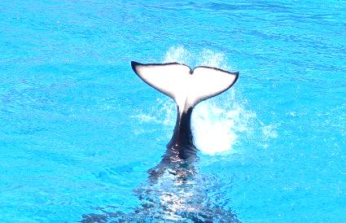
Hot Issue:
Controversies arising from the hunting of whales and dolphins(1) in Japan
According to the World Wide Fund (WWF) for Nature (Hong Kong), dolphins are closely related to whales and belong to the same group called the Cetaceans. For details, please visit http://www.wwf.org.hk/en/whatwedo/conservation/species/chiwhitedolphin/facts/

Slide 2
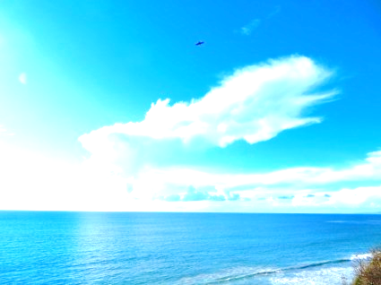
引言
In the beginning of this year, the US Ambassador to Japan, Caroline Kennedy condemned the brutal hunting of whales and dolphins in Wakayama. Her condemnation has again aroused concerns in different places over the world. In response, a Japanese official expressed that dolphins do not belong to internationally regulated species; therefore, the hunting of dolphins is not an illegal act. The commercial hunting of whales has a long history in Japan and dolphin meat is regarded as a kind of traditional Japanese food. The official claimed that these criticisms are due to cultural differences and he explained that Japanese fishermen have already been improving their whale-hunting methods in order to lower the level of cruelty. However, many environmental groups reject the viewpoints raised by the Japanese official. Every year, they would conduct demonstrations in Wakayama to show disapproval of brutal hunting of whales on a massive scale.
To take whale-hunting as an example, we can explore how we could maintain the sustainability of different species in nature while continue to develop the economy and maintain the traditional culture. What are the effective measures we could adopt to resolve the conflicts caused by cultural differences? Which international organizations can effectively solve the problems?

Slide 3
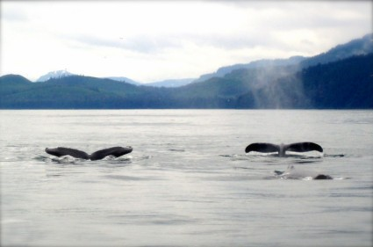
探討問題
1.What are the major global factors that lead to a widespread concern worldwide over dolphin-hunting in Japan?
2. Taking the dolphin and whale hunting industry in Wakayama as an example, in what ways do human economic activities threaten the sustainability of the marine species?
3. Based on your knowledge, what Chinese traditional food cultures have changed in order to maintain the sustainability of the marine species? Do you support the changes? Why?

Slide 4
Background
Greenpeace International (23 December 2010). Whaling on trial: Vindication! Japan finally starts taking action against its corrupt whaling industry. Retrieved from http://www.greenpeace.org/international/en/news/features/Whaling-whale-meat-vindication-231210/
Bloomberg Business week . (22 January 2014). Not only Dolphins. Japan Keeps Killing Whales, Too. Retrieved from http://www.businessweek.com/articles/2014-01-22/japans-dolphin-hunt-ends-for-the-year-and-the-whale-hunt-continues
Animal Planet. (n.d.). Why do the Japanese hunt whales? Whale wars. Retrieved from http://www.animalplanet.com/tv-shows/whale-wars/about-whaling/why-japanese-hunt-whales.htm
＞More Info
Background
Question for Enquiry (1)
Question for Enquiry (2)
Question for Enquiry (3)

Slide 5
Background
The Diplomat (10 December, 2010). Why Japan Keeps Whaling. Retrieved from http://thediplomat.com/2010/12/the-real-reason-japan-keeps-whaling/
The Japan Times. (1 February, 2014). Japan: Why kill whales off Antarctica? Retrieved from http://www.japantimes.co.jp/life/2014/02/01/environment/japan-why-kill-whales-off-antarctica/
The Japan Daily Press. (24 March, 2014). Whaling. Retrieved from http://japandailypress.com/tag/whaling/
CNN. (22 January, 2014). Japan officials defend dolphin hunting at Taiji Cove. Retrieved from http://edition.cnn.com/2014/01/20/world/asia/japan-dolphin-hunt/
＞More Info
Background
Question for Enquiry (1)
Question for Enquiry (2)
Question for Enquiry (3)

Slide 6
Background
One Green Planet. (11 February, 2014). The Truth Behind Japanese Whale and Dolphin Hunts. Retrieved from http://www.onegreenplanet.org/animalsandnature/the-truth-behind-japanese-whale-and-dolphin-hunts/
BBC News. (10 February 2014). New Zealand says Japan whalers “deeply disrespectful”. Retrieved from http://www.bbc.com/news/world-asia-26114510
Time. (20 November, 2007). Why Japan’s whale hunt continues. Retrieved from http://content.time.com/time/world/article/0,8599,1686486,00.html
＞More Info
Background
Question for Enquiry (1)
Question for Enquiry (2)
Question for Enquiry (3)

Slide 7
1.What are the major global factors that lead to a widespread concern worldwide over whale-hunting in Japan?
Deutsche Welle. (6 January, 2014). Anti-whaling activists pursue Japanese ships. Retrieved from http://www.dw.de/anti-whaling-activists-pursue-japanese-ships/a-17343422
International Whaling Commission. http://www.unep.ch/regionalseas/partners/iwcom.htm
Greenpeace USA. (n.d.). International Whaling Commssion. Retrieved from http://www.greenpeace.org/usa/en/campaigns/oceans/whale-defenders/iwc/
Deutsche Welle. (26 June, 2013). Australia takes Japan to court over whaling. Retrieved from http://www.dw.de/australia-takes-japan-to-court-over-whaling/a-16908286
＞More Info
Background
Question for Enquiry (1)
Question for Enquiry (2)
Question for Enquiry (3)

Slide 8
1.What are the major global factors that lead to a widespread concern worldwide over whale-hunting in Japan?
BBC News. (7 July, 2012). Call for UN debate rejected as whaling talks end. Retrieved from http://www.bbc.com/news/science-environment-18735621
Australia Network News. (7 July, 2012). Hunting nations block UN role on whales. Retrieved from http://www.abc.net.au/news/2012-07-07/an-japan-blocks-un-whale-role/4116380
Animal Legal & Historical Centre. (2002). Overview of Laws and Regulations protecting Whales. Retrieved from http://www.animallaw.info/articles/ovuswhalelaws.htm
The Economist. (14 March 2012).Good Whale Hunting.Retrieved from http://www.economist.com/blogs/babbage/2012/03/commercial-whaling
＞More Info
Background
Question for Enquiry (1)
Question for Enquiry (2)
Question for Enquiry (3)

Slide 9
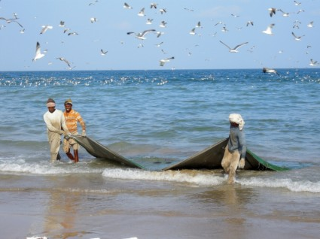
2. Taking the whaling industry in Wakayama as an example, in what ways do human economic activities threaten the sustainability of the marine species?
Discovery News. (21 March 2014). Nine Fisheries Cause Half of Drowned Whales, Wasted Fish. Retrieved from http://news.discovery.com/earth/oceans/nine-fisheries-cause-half-of-drowned-whales-wasted-fish-140321.htm
The Guardian. (20 March 2014). America’s nine most wasteful fisheries named. Retrieved from http://www.theguardian.com/environment/2014/mar/20/americas-nine-most-wasteful-fisheries-named
＞More Info
Background
Question for Enquiry (1)
Question for Enquiry (2)
Question for Enquiry (3)

Slide 10
2. Taking the whaling industry in Wakayama as an example, in what ways do human economic activities threaten the sustainability of the marine species?
The Huffington post. (21 March 2014). Washed Catch: It’s Time to Stop wasting Seafood. Retrieved from http://www.huffingtonpost.com/ted-danson/wasted-catch-its-time-to_b_5006453.html
Imperial Valley News. (23 March 2014). Trash to treasure: Stanford researcher tells a seafood story. Retrieved from http://www.imperialvalleynews.com/index.php/news/california-news/7758-trash-to-treasure-stanford-researcher-tells-a-seafood-story.html
Green Lodging News. (25 February, 2014). There’s much to consider when seeking out sustainable seafood. Retrieved from http://www.hotelnewsresource.com/article76569.html
＞More Info
Background
Question for Enquiry (1)
Question for Enquiry (2)
Question for Enquiry (3)

Slide 11
2. Taking the whaling industry in Wakayama as an example, in what ways do human economic activities threaten the sustainability of the marine species?
National Geographic. (26 February, 2014). Can World Leaders Tame the Wild West of the High Seas? Retrieved from http://newswatch.nationalgeographic.com/2014/02/26/can-world-leaders-tame-the-wild-west-of-the-high-seas/
PJ media. (28 February, 2014). Back to the Future. Retrieved from http://pjmedia.com/richardfernandez/2014/02/28/back-to-the-future-3/
The Republic. (2 March, 2014). New England groups win award for fisheries bycatch reduction effort. Retrieved from http://www.therepublic.com/w/ME--Fisheries-Bycatch
＞More Info
Background
Question for Enquiry (1)
Question for Enquiry (2)
Question for Enquiry (3)

Slide 12
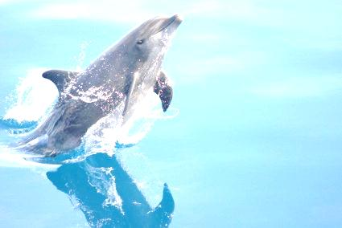
3. Based on your knowledge, what Chinese traditional food cultures have changed in order to maintain the sustainability of the marine species? Do you support the changes? Why?
Business Mirror. (1 March 2014). World Wildlife Day highlights urgent need to curb illegal trade. Retrieved from http://www.businessmirror.com.ph/index.php/en/features/biodiversity/28280-world-wildlife-day-highlights-urgent-need-to-curb-illegal-trade
Bizenergy. (31 January 2014). Ringing in the Lunar New Year with sustainable Chinese cuisine. Retrieved from http://www.bizenergy.ca/blog/ringing-in-the-lunar-new-year-with-sustainable-chinese-cuisine/
Bloomberg. (14 September, 2013). Hong Kong bans shark fin from official menus to save species. Retrieved from http://www.bloomberg.com/news/2013-09-14/hong-kong-bans-shark-fin-from-official-menus-to-save-species.html
＞More Info
Background
Question for Enquiry (1)
Question for Enquiry (2)
Question for Enquiry (3)

Slide 13
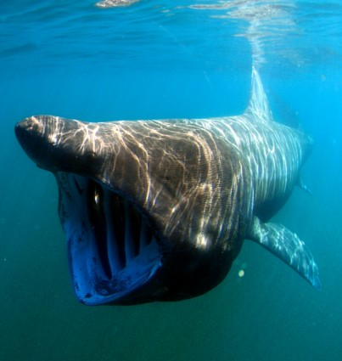
3. Based on your knowledge, what Chinese traditional food cultures have changed in order to maintain the sustainability of the marine species? Do you support the changes? Why?
The Phuket News . (30 January 2014). Fin Free Thailand encourages healthy, sustainable Chinese New Year by saying ‘NO’ to shark fin. Retrieved from: http://www.thephuketnews.com/fin-free-thailand-encourages-healthy-sustainable-chinese-new-year-by-saying-%E2%80%98no%E2%80%99-to-shark-fin-44324.php
HKSAR Press Releases. (13 September, 2013). Government determined to support sustainability-conscious food consumption. Retrieved from: http://www.info.gov.hk/gia/general/201309/13/P201309130572.htm
＞More Info
Background
Question for Enquiry (1)
Question for Enquiry (2)
Question for Enquiry (3)

Slide 14
3. Based on your knowledge, what Chinese traditional food cultures have changed in order to maintain the sustainability of the marine species? Do you support the changes? Why?
ABC Australia Plus. (14 September 2014). Shark fin and bluefin tuna off Hong Kong government menu. Retrieved from http://www.radioaustralia.net.au/international/2013-09-14/shark-fin-and-bluefin-tuna-off-hong-kong-government-menu/1190601
Highbrow. (14 April, 2014). Sustainable Agriculture Meets Big Business. Retrieved from http://highbrowmagazine.com/3896-sustainable-agriculture-meets-big-business
WWF. (Unknown). Save Our Ocean and Be Part of the Solution! Retrieved from http://www.wwf.org.hk/en/whatwedo/footprint/seafood/sharkfin_initiative/
Background
Question for Enquiry (1)
Question for Enquiry (2)
Question for Enquiry (3)

