Slide 1
高中公民與社會發展科知識增益系列： 香港社會的多元文化特徵
講者︰李浩然教授（香港大學建築保育副教授）、邱逸博士（中國文化研究院院長）
即 將 開 始
教育局通識教育/公民與社會發展組
2022年1月

Slide 2
高中公民與社會發展科知識增益系列： 香港社會的多元文化特徵
講者︰李浩然教授（香港大學建築保育副教授）、邱逸博士（中國文化研究院院長）
教育局通識教育/公民與社會發展組
2022年1月

Slide 3
中國文化研究院與教育局合辦 教師培訓研討會 非物質文化遺產 : 香港社會的多元文化特徵 Dr. Lee Ho Yin 李浩然 Associate Professor in Architectural Conservation, HKU 香港大學 建築保育副教授

Slide 4
What is Intangible Cultural Heritage (ICH)?

Slide 5
What is “intangible”?
“The best and most beautiful things in the world cannot be seen or even touched – they must be felt with the heart.”

Slide 6
What is “cultural heritage”?
UNESCO defines “cultural heritage” as (2002):
“The term ‘cultural heritage’ has not always meant the same thing. Recent decades have seen the concept of heritage — much like that of culture — undergoing a profound change. Having at one time referred exclusively to the monumental remains of cultures, heritage as a concept has gradually come to include new categories such as the intangible, ethnographic or industrial heritage. A noteworthy effort was subsequently made to extend the conceptualization and description of the intangible heritage.”
Source: http://portal.unesco.org/culture/en/ev.php-URL_ID=2185&URL_DO=DO_TOPIC&URL_SECTION=201.html

Slide 7
What is “cultural heritage”?
Cultural Heritage
/ \
Tangible Intangible
/ \
Movable Immovable
+
Tangible and intangible cultural heritage are inseparable – the former is the body and the latter is the soul; neither can exist without each other.
Quotable quote by Lee Ho Yin

Slide 8
What is “movable tangible cultural heritage”?
Cultural Heritage
/ \
Tangible Intangible
/ \
Movable Immovable
+

Slide 9
What is “movable tangible cultural heritage”?
Movable cultural heritage according to Australia’s NSW Heritage Office refers to “any natural or manufactured object of heritage significance,” such as:
1. Machinery and tools
2. Furniture, domestic collections
3. Transport items
4. Collections and archives
5. Religious or ceremonial objects
5. Fossils and botanical specimens
7. Museum objects and collections

Slide 10
What is “immovable tangible cultural heritage”?
Cultural Heritage
/ \
Tangible Intangible
/ \
Movable Immovable
+

Slide 11
What is “immovable tangible cultural heritage”?
Immovable cultural heritage according to UNESCO’s Convention for the Protection of World Cultural and Natural Heritage (“World Heritage Convention”) (1972) refers to:
Cultural Heritage (built structures)
1. Monuments
2. Groups of Buildings
3. Sites (usually archaeological)
Natural Heritage (ecology)
1. Natural Features
2. Geological and Physiographical Formations
3. Natural Sites

Slide 12
What is “immovable tangible cultural heritage”?
Immovable cultural heritage according to UNESCO’s Convention for the Protection of World Cultural and Natural Heritage (“World Heritage Convention”) (1972) refers to:
1. Monuments
2. Groups of Buildings
3. Sites (usually archaeological)

Slide 13
What is “intangible cultural heritage” (“ICH”)?
Cultural Heritage
/ \
Tangible Intangible
/ \
Movable Immovable
+
Intangible Heritage = Living Cultural Heritage

Slide 14
What is “intangible cultural heritage” (“ICH”)?
ICH according to UNESCO’s Convention for the Safeguarding of Intangible Cultural Heritage (“ICH Convention”) (2003) refers to:
1. Oral traditions and expressions, including language (especially endangered ones)
2. Performing arts
3. Social practices, rituals and festive events
4. Knowledge and practices concerning nature and the universe
5. Traditional craftsmanship

Slide 15
What is “intangible cultural heritage” (“ICH”)?
UNESCO says…
Intangible cultural heritage is…
traditional, contemporary and living at the same time;
inclusive;
representative;
community-based.
(Source: from UNESCO’s ICH website at https://ich.unesco.org/en/what-is-intangible-heritage-00003)

Slide 16
What about ICH that relates directly to our daily lives?
UNESCO says, intangible cultural heritage is…
(Source: from UNESCO’s ICH website at ich.unesco.org/en/what-is-intangible-heritage-00003)
traditional, contemporary and living at the same time;
inclusive;
representative;
community-based.
What qualifies for all of these and universally relatable to everyone?
How about… FOOD?

Slide 17
Food as ICH?

Slide 18
Food as ICH – as cultural pride and identity
UNESCO ICH Representative List: "Gastronomic meal of the French" (inscribed in 2010)
Source: https://ich.unesco.org/en/RL/gastronomic-meal-of-the-french-00437

Slide 19
Food as ICH – as cultural pride and identity
UNESCO ICH Representative List: “Washoku, traditional dietary cultures of the Japanese, notably for the celebration of New Year” (inscribed in 2013)
Source: https://ich.unesco.org/en/RL/washoku-traditional-dietary-cultures-of-the-japanese-notably-for-the-celebration-of-new-year-00869

Slide 20
Food as ICH – as cultural pride and identity
UNESCO Representative ICH List: “Mediterranean diet” (inscribed in 2013)
Source: https://ich.unesco.org/en/RL/mediterranean-diet-00884

Slide 21
Food as ICH – as cultural pride and identity
UNESCO ICH Representative List: “Beer culture in Belgium” (inscribed in 2016)
(Notice that it’s about the beer culture, and not the beer itself)
Source: https://ich.unesco.org/en/RL/beer-culture-in-belgium-01062

Slide 22
Food as ICH – as cultural pride and identity
UNESCO ICH Representative List:
“Kimjang, making and sharing kimchi in the Republic of Korea” (inscribed in 2013)
Source: https://ich.unesco.org/en/RL/kimjang-making-and-sharing-kimchi-in-the-republic-of-korea-00881
“Tradition of kimchi-making in the Democratic People’s Republic of Korea” (inscribed in 2015)
Source: https://ich.unesco.org/en/RL/tradition-of-kimchi-making-in-the-democratic-people-s-republic-of-korea-01063

Slide 23
Food as ICH – as cultural pride and identity
UNESCO Representative ICH List: “Hawker culture in Singapore, community dining and culinary practices in a multicultural urban context” (inscribed in 2020)
Source: https://ich.unesco.org/en/RL/hawker-culture-in-singapore-community-dining-and-culinary-practices-in-a-multicultural-urban-context-01568

Slide 24
Iconic Hong Kong Food as ICH?

Slide 25
Food as ICH – as cultural pride and identity
Proposed Hong Kong ICH for UNESCO ICH Representative List: “Yum cha culture of Hong Kong”? (Focusing on the social practice of yum cha, rather than on dim sum as a craft)

Slide 26
Food as ICH – as cultural pride and identity
Proposed Hong Kong ICH for UNESCO ICH Representative List: “Cha chaan teng culture of Hong Kong” (Focusing on the social practice of cha cheng teng, rather than cha cheng teng food as a craft)

Slide 27
What is happening with ICH in Hong Kong?

Slide 28
What’s happening with ICH in China?
Aug 2004
The People’s Republic of China ratifies the 2003 ICH Convention and become a signatory of the convention, which applies to the HKSAR as well.
Apr 2006
The Guangdong Cultural Department (廣東文化廳) announces the 1st provincial-level ICH list with 78 items.
May 2006
China’s State Council (中國國務院) announces the 1st national-level ICH list with 518 items.
Jun 2011
China’s State Council announces the current national-level ICH list with 1,219 items.
Jun 2021
China’s State Council announces the current national-level ICH list with 1,557 items, 42 of which has been inscribed on the UNESCO Representative ICH List.

Slide 29
What’s happening with ICH in Hong Kong?
28 May 2006
Macau Daily News reports, “Herbal tea a national-level intangible cultural heritage [of the Macau and Hong Kong SARs].”

Slide 30
What’s happening with ICH in Hong Kong?
22 January 2007
SCMP reports on the start of preparing a HK ICH Inventory (not a List – that comes later): “Team to record intangible heritage”
Source: https://www.scmp.com/article/579142/team-record-intangible-heritage

Slide 31
What’s happening with ICH in Hong Kong?
29 September 2009
SCMP reports on 4 HK ICH items included on China’s national ICH list: “4 festivals proposed to be protected as national heritage”

Slide 32
What’s happening with ICH in Hong Kong?
2 October 2009
SCMP reports on a HK ICH item listed on the UNESCO ICH Representative List: “Unesco gives Cantonese opera something to sing about”
Source: https://www.scmp.com/article/694276/unesco-gives-cantonese-opera-something-sing-about

Slide 33
What’s happening with ICH in Hong Kong?
12 February 2011
SCMP reports on the HK’s first tentative ICH inventory: “Umbrella maker, salted fish on list of intangible treasures”
Source: https://www.scmp.com/article/737922/umbrella-maker-salted-fish-list-intangible-treasures

Slide 34
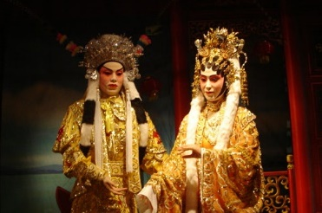
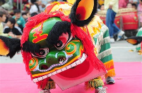
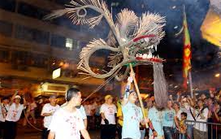
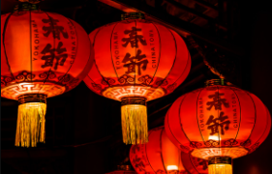
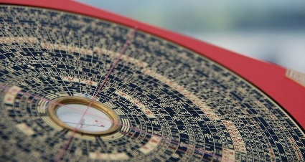
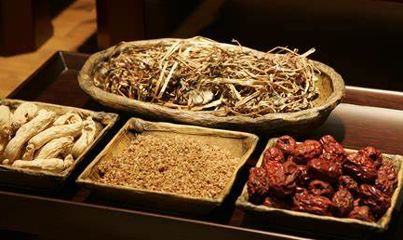
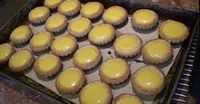
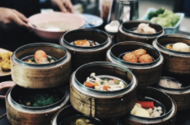
What’s happening with ICH in Hong Kong?
1. Oral Traditions and Expressions
17 June 2014
SCMP reports on HK’s first ICH Inventory: “The 480 things that represent Hong Kong's culture: list unveiled after seven years' work”
Source: https://www.scmp.com/news/hong-kong/article/1534746/cantonese-opera-dim-sum-and-diwali-hong-kong-lists-its-cultural
Photo by / CC0 1.0
2. Performing Arts
Photo by 长夜无风 / CC BY-SA 3.0
Photo by Sou-Yi Yang / CC BY-NC-ND 2.0
3. Social Practices, Rituals & Festive Events
Photo by Dilontai / CC BY-SA 3.0
Photo by aotaro / CC BY 2.0
4. Knowledge & Practices Concerning Nature & the Universe
Photo by / CCO 1.0
Photo by / CCO 1.0
5. Traditional Craftsmanship
Photo by KINGTARTS / CC BY-SA 3.0
Photo by / CCO 1.0

Slide 35
Hong Kong’s 1st ICH Inventory (2014)
1. Oral Traditions and Expressions
2. Performing Arts
1 Hakka Dialect
2 Wai Tau Dialect
3 Cantonese
4 Four-character idiomatic expressions
5 Fishermen’s Dialect
6 Fujian Dialect
7 Fujian's Hokkien (Minnan) Dialect
8 Fujian's Fuzhou Dialect
9 Chiu Chow Dialect
10 Hoi Luk Fung / Hoklo Dialect
11 Riddles
12 Cantonese Chanting
13-23 Oral Legends of New Territories lineages
24 Lion Dance
25 Dragon Dance
26 Pixiu (an imaginary beast) Dance
27-30 Unicorn Dance
31 Engor (Dance of Heroes)
32-37 Cantonese Opera
38 Fujian Opera
39-44 Puppetry
45 Eight Categories of Instrumental Music (a type of music in Guangdong)
46-48 Ritual Music (Taoist and Buddhist)
49 Rite Music
50 Cantonese Music (flourished 1920s-50s)
51 Chiu Chow Music
52 Nanyin (Southern Tunes
53 Fujian Nanyin
54 Zhuzhici Poems/Village Names in a Song
55 Hakka Folk Song
56 Funeral Laments
57 Wedding Laments (a Hakka ritual)
58-61 Fishermen’s Laments
62 Fishermen's Ballads

Slide 36
Hong Kong’s 1st ICH Inventory (2014)
3a. Social Practices, Rituals and Festive Events - FESTIVALS
63 Che Kung (General Che)
64-67 Tai Wong Yeh (Great Lord) Festival
68 Tin Kung Yuk Wong Tai Tai (Jade Emperor)
69 Kwan Tai (God of War)
72 Lantern Lighting Ritual
89 Tai Ping Hung Chiu (ceremony for purification)
94 Pa Tin Gei (ceremony for purification)
97 To Tei (Earth God)
107 Spring and Autumn Ancestral Worship of Lineage
128 Man Cheong (God of Literature and Bureaucracy) Festival
129 Hung Shing (God of the Sea) Festival
139 Kwun Yum (Goddess of Mercy) Festival
143 Guang Ze Zun Wang (Revered King of Broad Blessings) Festival
144 Sam Shan Kwok Wong (Kings of Three Mountains) Festival
145 Pak Tai (Supreme Emperor of the North) Festival
148 Offering Sacrifices to White Tiger during Insects Awakening Day
149 Chun Kwan Emperor Festival
150-175 Tin Hau (Empress of Heaven) Festival
176-178 Tam Kung (Lord Tam) Festival
179 LiLing Divine Festival
180 Kam Fa (Lady Golden Flower) Festival
181 Feast Day
182-186 Dragon Boat Festival
187-189 Lung Mo (Dragon Mother) Festival
190 Man Cheong (God of Literature) and Mo Tai (God of Martial Art) Festival
191 Chou (Zhou Youde) Wong (Wang Lairen) Yi Kung
192-194 Hau Wong (Marquis Prince) Festival
195 Lo Pan (Master) Festival
196 The Seventh Sister’s Birthday Festival
197-286 Yu Lan Festival
287-290 Tei Chong Wong (Ksitigarbha Bodhisattva) Festival
291-293 Fire Dragon Dance
294 Chai Tin Tai Shing (Monkey King) Festival
295 Wong Tai Sin Festival
296 Yuen Tin Sheung Tai (Supreme Emperor of the Dark Heaven) Festival
297 Tei Mo Yuen Kwan (Earth Mother Goddess) Festival
298-302 Wah Kwong (God of Fire and patron of Cantonese opera) Festival
303 Autumn Sacrificial Rites
304 Ancestral Worship of the Kwok Clan in Kowloon City
305 General Cheung Fei Festival
306 Thanking Deities
307-323 Jiao / Da Chiu
324 International Mother Language Day
325 Diwali (Festival of Lights), a Hindu tradition
326 Teej (Festival of Women), a Nepalese celebration
327 Poem Reciting Function, a Pakistani tradition
328 Holi (Hindu Festival of Colours)
329 Dussehra (Hindu Festival of Victory of Good over Evil)
330 Annakut (New Year's Day in Hindu)
331-337 Orthodox Unity School Taoist Tradition (New Territories)
338 Orthodox Unity School Taoist Tradition (Urban)
339-346 Complete Perfection School Taoist Tradition
347 Cantonese Rite of Liberating the Flaming-mouths (Feeding the Hungry Ghosts)
348 Traditional Funeral Rites
349-354 Traditional Wedding Ceremonies
355 Enshrinement ceremony for the Chinese Unicorn (once every 10 years)
356 Vegetable Tea preparation during festivals
357 Sek Shan Tou (Eating on the Hillside)
358 Basin Meal
359 Sticking Hui Chun (Spring Scrolls)

Slide 37
Hong Kong’s 1st ICH Inventory (2014)
3b. Social Practices, Rituals and Festive Events – MARTIAL ARTS
360 Tai Shing Pek Kwar Moon Style (Monkey and Axe Hammer Style) - wushu
361-365 Tai Chi Chuan
366 Northern Shaolin Tay Tong Pak Kar
367-368 Weng Chun Fist
370 Pak Hok Pai (White Crane) Fist
371 Southern Shaolin Ng Cho Kun (Five Ancestors Fist) Tiebigong (Iron Arm Skill)
372-377 Hung Gar Kuen Style
378 Fu Style Bagua Quan (Fu Style Eight Trigrams Fist)
379 Hua Yue Xin Yi Liu He Ba Fa Chuan (Six Harmonies Eight Methods Boxing)
380 Wing Chun Fist
381-383 Pao Fa Lien Wing Chun; Snake Crane Wing Chun; Yip Man Wing Chun
384-386 Cangzhou Wushu
387-389 Choi Lee Fat Fist
390 Lung Ying Fist (Dragon Sign Fist)
391-395 Tanglangquan (Northern Praying Mantis)

Slide 38
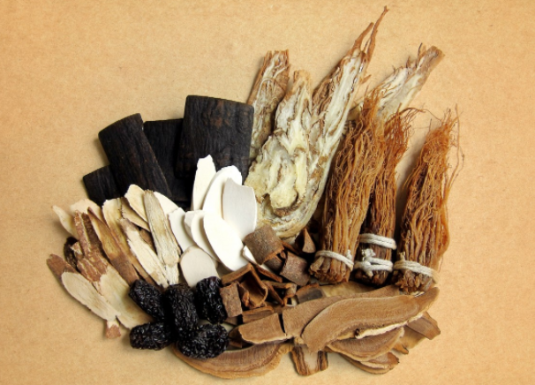
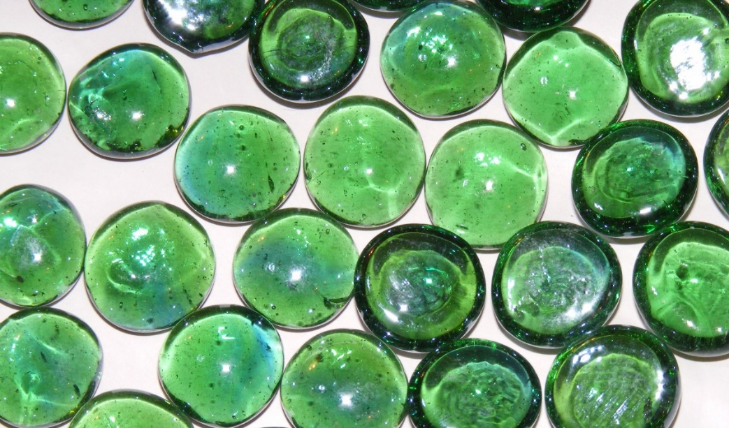
Hong Kong’s 1st ICH Inventory (2014)
4. Knowledge and Practices Concerning Nature and the Universe
Photo by / CCO 1.0
Photo by / CCO 1.0
396-399 Culture of Traditional Chinese Medicine
400 Fishermen’s knowledge about the universe and the nature
401 Traditional Jade Stone Knowledge
402 Traditional Chinese Almanac

Slide 39
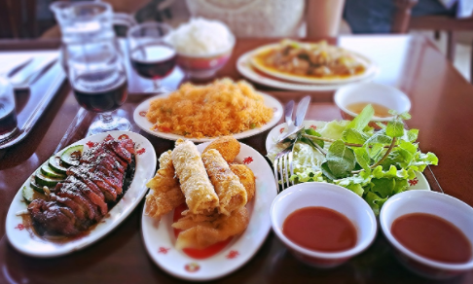
Hong Kong’s 1st ICH Inventory (2014)
5a. Traditional Craftsmanship – FOOD (this beggars the question: why is food a craft and not a social practice?)
Photo by / CCO 1.0
403 Fermented Black Soybean
404 Bean Curd
405 Seafood Sauce
406 Preserved Fruit
407 Fei Gei Lam (Aeroplane Olive)
408 Soy Sauce by local factories
409 Sesame Oil
410 Fish Maw
411 Shrimp Paste Blocks and Shrimp Paste
412 Pickled Vegetable
413 Soy Sauce (Fujian Sauce Factories)
414 Preserved Meat
415 Brewing Glutinous Rice Wine
416 Dried Oyster and Oyster Sauce
417 Fermented Soybean Sauce
418 Salted Fish
419 Moon Cake
420 Melon Seed (the snack)
421 Betrothal Cakes
422 Chiu Chow Sugar Loaf
423 Chiu Chow Style Sweets and Cakes
424 Chiu Chow Five Assorted Betrothal Cakes
425 Glutinous Rice Dumpling
426-427 With lye or with pork
428 Sau Fan
429 Shek Lau Tsai
430 Cha Kwo (Steamed Sticky Rice Dumpling)
431 Ching Ming Tsai (Paederia scandens Sticky Rice Dumpling)
432 Sweet Potato Cake
433 Hakka Cuisine
434 Cantonese Cuisine
435 Chinese Dim Sum
436 Chiu Chow Marinated Food
437 Dumpling
438 Noodles
439 Egg Tart
440 Pineapple Bun
441 Wonton
442 Hong Kong Style Milk Tea
443 Yuan Yang Mixed Milk Tea and Coffee
444 Ding Ding Candy
445 Blown Sugar (small balloon can be made from syrup)

Slide 40
Hong Kong’s 1st ICH List (2014)
5b. Traditional Craftsmanship - CRAFTS
446-455 Paper Crafting
456 Drawn Work Figurine
457 Wreath Crafting
458 Flower Board Crafting
459-461 Wood Carving
462 Charcoal Drawing
463 Mirror Painting of Deity Image
464 Gravestone Carving
465 Gold Leaf Decoration
466 Ivory Carving
467 Shiwan Pottery
468 Painting Mounting
469 Paper-cutting Technique
470 Lacquerware
471 Guangcai (The Canton Famille Rose Porcelain)
472 Seal Carving
473 Gravure-type Printing
474 Movable-type Printing
475 Dough Figurine Crafting
476 White Herring Bone Ornaments
477 Mahjong Tile Making
478 Brocade Box Making
479 Birdcage Production
480 Guqin (seven-stringed plucked instrument)
481 Umbrella Making
482 Piu Sik (Floating Colours) Making
483 Tattoo Technique
484 Face Threading Technique
485 Leather Shoe Making
486 Quilt Making
497 Sewing techniques
501 Lantern Band Embroidery
502 Cantonese Opera Headdress Crafting
503 Cantonese Opera Costume Embroidery
504 Jade Carving
505 Jewellery
506 Galvanised Iron Products
507 Chopping Board
508 Steamer
509 Cake Mould
510 Wooden Furniture Crafting
511 Coffin Crafting
512 Ying Stone (ornamental limestone from Yingde) Rockery Miniature Landscape Crafting
513 Gardening
514 Stilt House Construction
515 Traditional Architecture Preservation
516 Bamboo Shed Theatre Building
517 Wooden Boat Building
518 Fishing Method
519 Fishing Net Plaiting Technique
520 Aquaculture of Seawater fish
521 Gei Wai (Inter-tidal shrimp ponds) Operation
522 Aquaculture of Fresh-water Fish
523 Oyster Farming
524 Rice Cultivation
525 Vegetable Cultivation
526 Salt Making
527 Honey making
528 Pig Raising
529 Chicken Raising
530 Guangdong Hand Puppets Making
Image source: South China Morning Post

Slide 41
What’s happening with ICH in Hong Kong?
In 2015, the HKSAR Government established the Intangible Cultural Heritage Office (under the Leisure and Cultural Services Department).
Source: https://www.lcsd.gov.hk/CE/Museum/ICHO/en_US/web/icho/home.html

Slide 42
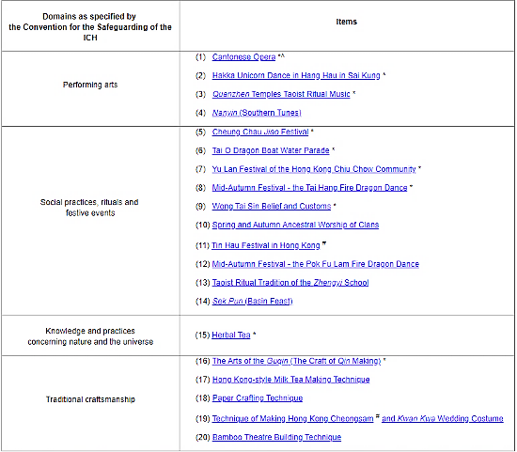
What’s happening with ICH in Hong Kong?
From the HKSAR Government’s Intangible Cultural Heritage Office website:
“The Leisure and Cultural Services Department announced on 14 August 2017 the first Representative List of the Intangible Cultural Heritage of Hong Kong, which comprises 20 items. The Representative List will provide the Government with a basis for prioritising resources and safeguarding measures for intangible cultural heritage (ICH) items, especially those of high cultural value and with an urgent need for preservation.”

Slide 43
ICH as Hong Kong’s Cultural Diversity and Identity

Slide 44
What is “intangible cultural heritage” (“ICH”)?
Cultural Heritage
/ \
Tangible Intangible
/ \
Movable Immovable
+
Intangible Heritage = Living Cultural Heritage

Slide 45
Hoyin's commentary on the heritage conservation part of the 2007 Policy Address
South China Morning Post, 11 October 2007
Source: https://www.scmp.com/article/611086/welcome-embrace-living-city

Slide 46
Thank you
Image source: www.wingsofasia.com

