Slide 1
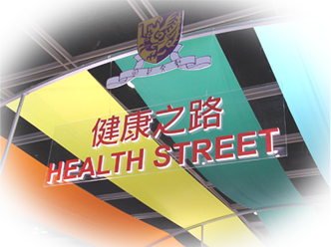
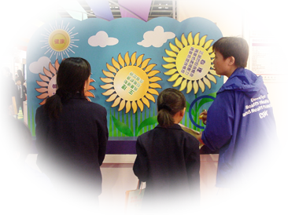




Health Promoting School Model to tackle Internet addiction
如何透過健康校園促進健康使用互聯網及電子屏幕產品
Professor Albert Lee MB BS(Lond) LLB (Hons-Lond) MPH LLM (Distinvt-Arbitration &DR) MD (Higher Med.Res.Deg) ) US Nat.Acad.Med (Foregin Associate) FFPH(UK) FRCP (Lond & Ireland) FRACGP(Aus) Email: alee@cuhk.edu.hk
Director of Centre for Health Education and Health Promotion and Clinical Professor of Public Health The Chinese University of Hong Kong
李大拔教授
香港中文大學公共衛生及基層醫療臨床教授、健康教育及促進健康中心總監
Member of Forum of Investing in Children Globally, US National Academy of Medicine

Slide 2
Outline of seminar
Recap of size of problems, identification of the problems and potential associating factors
Options of management
Analysis of the Health Promoting School framework would help Internet addiction

Slide 3
Review of size of problems and risk factors
The number of Internet users has increased by 1000% over last 15 years. Internet addiction is associated with socio-demographic variables (male gender, younger age and high family income), Internet use variables including time spent and using gambling and game applications, psycho-social factors (impulsivity, neuroticism and loneliness), and comorbid symptoms (depression, anxiety and psychopathology), all these factors contribute to increased vulnerabiluty. (Kuss DJ et al. Internet addiction clinical research review WJ Psychiatry 2016; 6(1): 143-176)
Higher prevalence in adolescents in China (8.8% Xu J et al. BMC Public Health 2012; 12: 1106 vs 0.8% Italy Poli R et al. Nord J Psy 2012; 66: 55-59)
China has acknowledged Internet addiction as official disorder in 2008 (Barkoviak M et al. Daily Tech 2012)
In clinical contest, internet addiction can be perceived as mental disorders requiring professional help such as mood modification, tolerance, withdrawal, conflict and relapse.

Slide 4
Identification of problems and intervention
In 2002, the South Korean government-funded National Information Society Agency opened the first internet addiction prevention counselling centre to include prevention, training, counselling, treatment and policy formulation (Koh YS. The Korean national policy for Internet Addiction. In Montag C, Reuter M. Internet addiction, Neuroscientific approaches and therapeutic interventions. London: Springer, 2015: 219-234.)
Internet addiction criteria; preoccupation, tolerance, loss of control, withdrawal, overall impairment, deception, and escaptism (Te Wildt et al. Eur J Psy 2010; 24: 136-145). Tao et al criteria: preoccupation and withdrawal combined with at least one of the following: Tolerance, lack of control, continued excessive uses despite knowledge of negative effects/affects, loss of interests and use of internet for relief of dysphoric mood. (Addiction 2010; 105: 556-564)

Slide 5
Identification of problems and intervention
There are various format of assessment (criteria, checklist or scales).
In Asian context, Chou et al has reviewed that number of hours spent on ‘Bulletin Board System’ and email are predictors for determining Internet addictions. Internet application with interactive functions appears to contribute to pathological Internet use. (Chou C et al. A Review of the Research on Internet Addiction. Education Psychology Review. 2005; 17(4): 363-387)
Chou et al (2005) has also reviewed Internet and other psycho-social variables. In study by Lavin et al (1999) (Cyber Behav, 2(5): 425-30) in contrary to expectations found that dependent Internet users score lower on the sensation-seeking score (SSS) as well as the thrill and adventure seeking. One possible explanation is that SSS is more appropriate for assessing sensation seeking through various physical activities.
Another study from 750 Taiwan High School students by Lin and Tsai (2002) (Comput. Human Behav, 18(4): 411-426) showed dependent Internet users scored higher on a scale of overall sensation seeking and on the disinhibition scale.

Slide 6
Identification of problems and intervention
Addict group found the Internet entertaining, interesting, interactive and enjoyable. Most powerful predictor of Internet addiction was found to be the communication pleasure score, followed by BBSs use hours, gender, satisfaction (gratification) score and email use hours (Chou C and Hsiao (2000). Comput. Edu, 35(1): 65-80.
Increases levels of depression have been found to be associated with Internet addiction. Low self-esteem, poor motivation, fear of rejection, and need for approval are associated with depression contributing to increased Internet use.(Young KS and Rogers RC (1998). Cyberpsychol. Behav, 1(1): 25-28)

Slide 7
Identification of problems and intervention
Pathological users were found to be lonelier. (Morahan-Martin JM and Schumacker P (2000). Compu. Human Behav, 18(4): 411-426.) Internet as low-rsk social approach (Campbell et al (2006). Cyberpsuchol Behav, 9(1): 69-81)
Internet itself might not be addictive and pathological use would be related to the ‘anonymity’ and the ‘interactivity’ that Internet can be place to relax, escape pleasures and seek excitement.
Internet as a coping mechanism against underlying psychological development issues such as identity and intimay (5th and 6th Ericksonian crisis). (Ko CH et al (2006). Can J Psy, 51 (14): 887-894)

Slide 8
Neuro-biology
In the addicted group, the right orbito-frontal cortex, right nucleus accumbens, bilateral prefrontal congulate and medial frontal lobe, right dorsolateral prrefrontal cortex and right caudate nucleus were activated compared with control group. (Ko CH et al. Psychiatry Clin Neurosci 2009; 63(3): 357-364)
The results shown that neural substrates of cue-inducing gaming, urge/craving in online gaming addiction was similar to that of the cue-induced craving in substance dependence sharing same neuro-bioliogical mechanism.(Weinstein A and Lejoyeux M (2010). Interent Addiction or Excessive Internet Use. Am J of Drug and Alcohol Abuse, 36(5): 277-283.
Addictions activate a combination of sites in the brain associated with pleasure known as the ‘reward centre’. When activated, dopamine is increased along with opiates and other neurochemicals and over time the associated receptors may be affected producing tolerance and need for increased stimulation of the ‘reward centre’. (Cash H et al. Internet Addiction: A Brief Summary of Research and Practice. Current Psychiatry Review 2012; 8: 292-298.)

Slide 9
Management
Kuss et al (2016) have reviewed studies on psychopharmacology treatment for Internet addiction and/or gaming addiction and showed positive effects in decreasing Internet addiction symptomatology and use time. In few studies, anti-depressant medication has been used suggesting disorders may co-exist with Internet use addiction so medication used to treat those disorders would also be effective for Internet addiction related problems.
Most common approach would still be Cognitive Behaviour Therapy (CBT). Typical CBT is administered over few months ranging including group and individual

Slide 10
Management
Kuss et al (2016) have reviewed studies on psychopharmacology treatment for Internet addiction and/or gaming addiction and showed positive effects in decreasing Internet addiction symptomatology and use time. In few studies, anti-depressant medication has been used suggesting disorders may co-exist with Internet use addiction so medication used to treat those disorders would also be effective for Internet addiction related problems.
Most common approach would still be Cognitive Behaviour Therapy (CBT). Typical CBT is administered over few months ranging including group and individual

Slide 11
Topics for CBT
(Kuss DJ et al. Internet addiction clinical research review WJ Psychiatry 2016; 6(1): 143-176)
Identification of the internet application associated with symptoms of addiction
Control issues such as examining self, feelings, impulsivity, and relationship between the individual and the Internet to self management and self restraint
Healthy Communication/interpersonal communicatoon, e.g., parent-children, sharing successful stories
Internet awareness, e.g., dealing with online content
Cessation technique (recognising the addictive behaviour and discontinuing)
Other elements such as career and life planning, coping with academic problems, burnout, problems with peers

Slide 12
Group therapy approach
Multimodal School Based Group (MSBG) involving students, parents and teachers. Students will use classical CBT.
Parents will receive training to recognise children’s Internet addiction through their feelings, communication and problem solving skills in family and parents controlling their own feelings and behaviours to manage children’s excessive use.
Teachers should also be provided psychoeducation through lectures, analysis and discussion to recongise and manage Internet addiction in students and supporting parents.

Slide 13
Group therapy approach
Multimodal Family Group Therapy (MFGT) provides therapeutic groups for both parents and students.
It provide peer support, allowing transferential reactions, engagement with family and promoting family cohesion
Improving parent-adolescent communication and closeness as well as communication practices related to Internet addiction problems
Explore the associations between psychological needs and Internet use and fulfilling the family members’ psycho-social needs.
Setting up a healthy expectation for the family system
Liu QX et al. MFGT for adolescent Internet addiction and exploring the underlying mechanism. Addict Behav 2015; 42: 1-8

Slide 14
Multi-level Intervention Model
Individual based counselling with motivating interviewing (MI), family based counselling
Emphasizing controlled and healthy Internet use
Promoting the understanding of the change process through the different stages of behavioural change from pre-contemplation to relapse
Using MI model
Addressing family perspective system approach
Multi-level counselling including students, family members and peers
Using individual and group therapy to facilitate

Slide 15
© Professor Albert LEE 李大拔教授 2017
Community LinkSlide 28
Home-school co-operation to facilitate multi-level communication and understandings
Community resources to help students promoting self-esteem, closer connectedness, inter-personal relationship
Action Competency on Healthy LivingSlide 16
Comprehensive curriculum with health related issues for students to acquire health skills-School provides time for students to explore and comprehend content area on Internet addiction
School provides diversified health education resources for staff and parents on Internet addiction and such resources should be centralised and well managed
Healthy School PolicySlide 22
Comprehensive healthy youth development including policies on prevention of dependent or indulgent behaviour including Internet addciction, active school and also harmonious school
Wide consultation with professionals, community leaders and stakeholders
System of awarding students in wider perspectives
Internet Excess Use
Social EnvironmentSlide 27
Addressing needs of students- promotes the students’ self-confidence through positive reinforcement, a system in place to look after students with emotional needs and/or unexpected traumatic life events.
System for the prevention, and management of unacceptable behaviour in school and encourages staff to set personal examples for cultivating students’ positive actions.
Respect students’ diversity
Caring and harmonious atmosphere
Develop atmosphere of mutual trust and sharing
School Health Care and Promotion ServicesSlide 23
Primary prevention: avoid exposure to risk factors and build up protective factors
Secondary prevention: identification of at risk cases and appropriate management in school setting ± referral for treatmnt
Tertiary prevention: and appropriate counseling and/or specific individual
Physical EnvironmentSlide 26 Safety
Healthy school environment for physical and leisure activities
Green environment

Slide 16
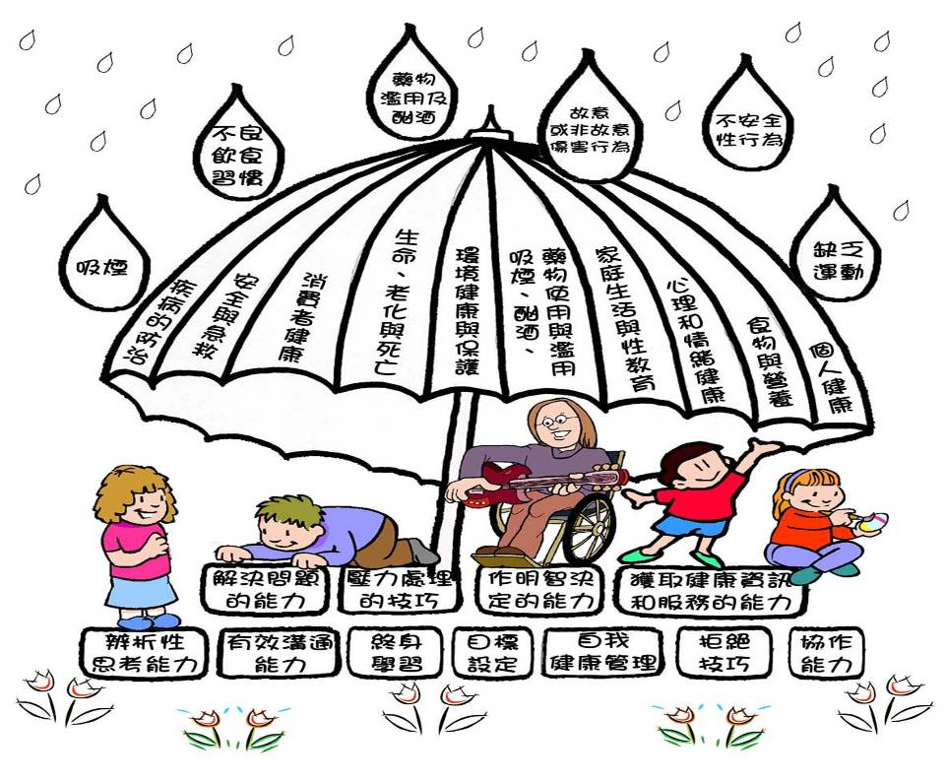
十大健康主題

Slide 17
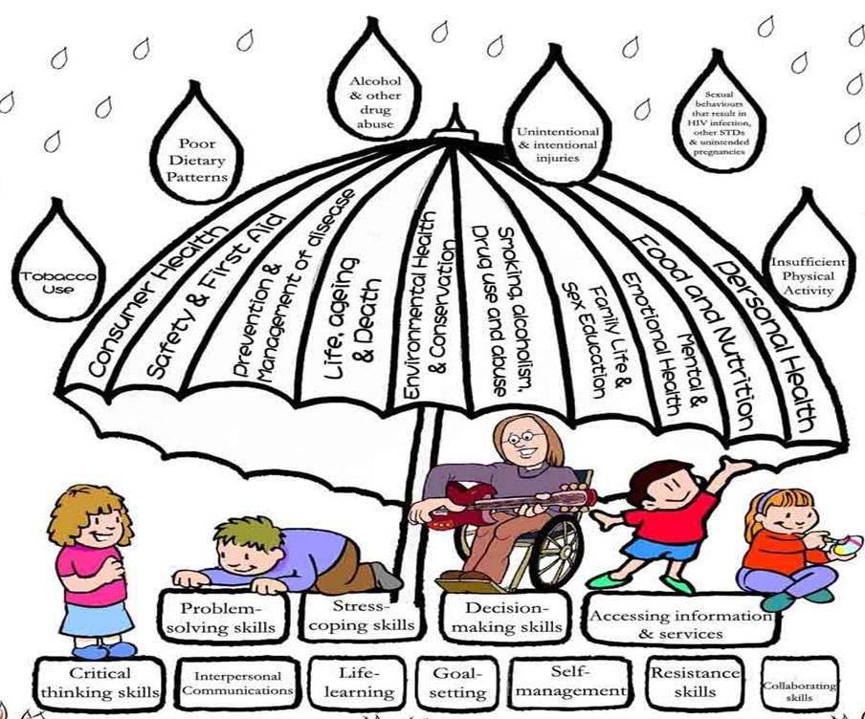

Slide 18
Action competencies for Healthy Living
Training in time management.
Introducing alternative activities to the problematic behaviours.
Multimodal treatments including parent training, teacher education and group cognitive behaviour therapy to improve emotional state and regulation ability, behavioural and self management style.
Promoting understanding of the change process through different stages of change from pre-contemplation to relapse (Prochaskat and Diclemente 1984).

Slide 19
Psycho education for teachers.
Parent-adolescent communication skills and problem solving skills.
Setting up healthy expectations for the family system.
How to satisfy the unfulfilled need in family relationship.

Slide 20
Behaviour change
Stages of change Model (Prochaskat Diclemente 1984)
Relapse
Precontemplation Individual not interest in change in the next 6 months
Contemplation Individuals is thinking about change (considering to quite over next 6 months)
Maintaining the change
Maintaining the Healthier Lifestyle
(abstinent over 6 months)
Ready to change (planning to quit over next 30 days)
Making a change Who have quitted over 6 months)

Slide 21
Choosing effective approach
Not ready group- show interest and encourage them to think about it
Unsure- Motivate change and offer help and overcome barriers
Ready- provide assistance to develop a plan to regulate excess use
Suggest coping strategies
- Delay, deep breath, do something else
- Assist with pharmacotherapy if indicated
- Encourage social support
Action – Congratulate on progress and check for problems
Maintenance – Congratulate and reinforce benefits of being rational user.Slide 15

Slide 22
Healthy School Policies
Harmonious school – promoting healthy communication e.g. interpersonal communication.
Active schools – healthy activities activate the ‘reward centre’ in lieu of addictive behaviours such as excess internet use.
Prevention of dependent or indulgent behaviour –minimization of internet addiction by reinforcement / reward of healthy behaviours and avoiding any potential ‘reward’ / reinforcement of excess internet use.

Slide 23
School Health Care and Promotion Services
Early identification of potential internet excess use students.
Multi level counselling for students, peers and family.
Multi-modal school-based group (MSBG), multi-family group therapy (MFGT), multi-level intervention.

Slide 24
Brief motivation interviewing
Motivational interviewing is a key skill for assessing the unsure group of smokers. It involves asking open-ended questions, reflective listening and summarising. Ambivalence about health risk behaviour, e.g., smoking (likes and dislikes) should be acknowledged and discrepancies in beliefs and personal goals can be discussed.

Slide 25
Top 10 useful questions
What changes would you most like to talk about?
What have you noticed about . . .?
How important is it for you to change . . .?
How confident do you feel about changing . . .?
How do you see the benefits of . . .?
How do you see the drawback of . . .?
What will make the most sense to you?
How might things be different if you . . .?
In what way . . .?
Where does this leave you now?Slide 15

Slide 26
School Physical Environment
Provision of suitable physical environment to enhance learning – school provides sufficient amenities for students or staff to rest and relax to prevent psycho-social disorders.
Provision of safe environment – students would feel safe in school setting to encourage active schoolSlide 15

Slide 27
School’s Social Environment
Addressing the needs of students and staff - fulfilling psychological needs of students and family.
Developing students’ leadership and communication skills.
Creating an environment of friendliness and care in school – reflective listening, affirmation to help individuals expressing their concerns.Slide 15

Slide 28
Community Links
Improving parent – adolescent communication and closeness.
Linking with community to provide activities for students with feeling of pleasure and reward.

Slide 29

謝謝各位!
聯絡我們：chep@cuhk.edu.hk
香港中文大學醫學院
健康教育及促進健康中心
http://www.cuhk.edu.hk/med/hep

