Slide 1

回收知多少?
Choose the correct answer. https://play.kahoot.it/#/k/4764e204-9ba1-44f6-9023-a2754701024b

Slide 2
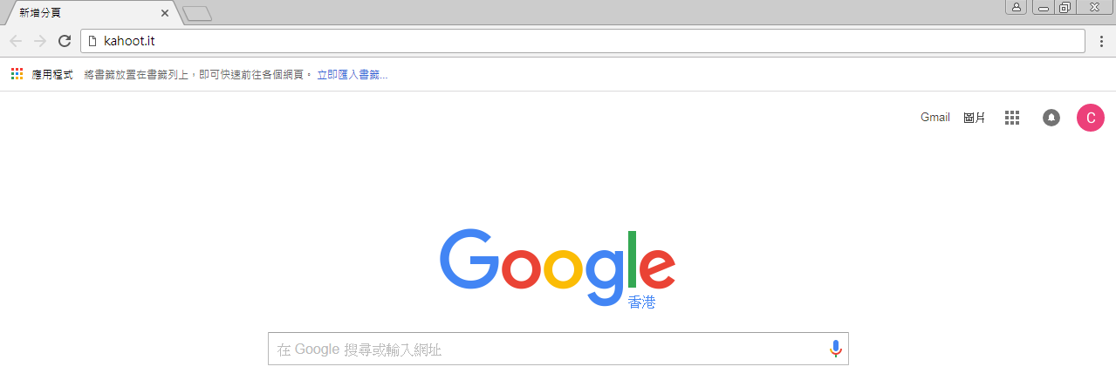

Step 1
Step 2
Enter the Game PIN,
Followed by a nickname.
website: Kahoot.it

Slide 3
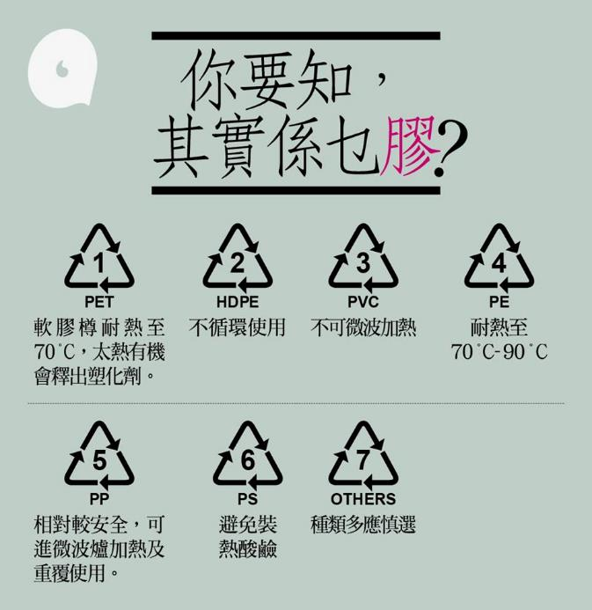
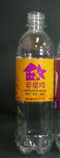




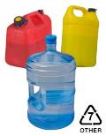


Slide 4
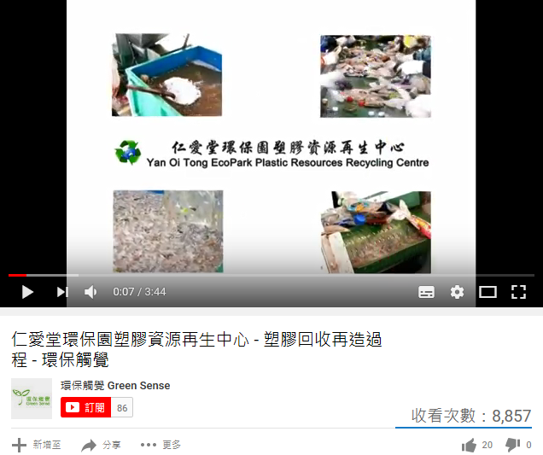
本地回收並變回原料 - 仁愛堂環保園塑膠資源再生中心Http://www.greensense.org.hk/plasticbag/subpage1k.php

Slide 5

LS Learning and Teaching Exemplar
Understanding the Municipal Solid Waste Management in Hong Kong

Slide 6
Learning and Teaching Exemplar
Experiential learning on solid Waste management
Issue:
Understanding the municipal solid waste management in Hong Kong
Relevant Module & themes
Module 6: Energy Technology and the Environment;
Theme 2: Environment and Sustainable Development
Module 2: Hong Kong Today; Theme 1: Quality of Life

Slide 7
Learning objectives
Knowledge
To understand the current situation of municipal solid waste in Hong Kong.
To understand how the Hong Kong Government responds to the issue of municipal solid waste.
To evaluate the effectiveness of different solid waste management measures adopted in Hong Kong.

Slide 8
Learning objectives
Skills
To develop skills in identifying features of solid waste, decoding cartoons and evaluating the effectiveness of different solid waste management measures.
To apply relevant knowledge and concepts in discussing contemporary issues.
Values and attitudes
To increase the awareness on environmental protection.

Slide 9
Design of learning and teaching approach
Connection between learning and lives
Learning becomes ‘real’ by experiencing and applicable in daily lives.
Personal level
School / community level
Societal level

Slide 10

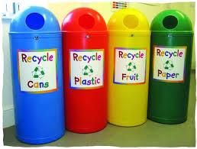
Solid Waste Management at school
What measures does the school adopt to tackle solid waste problems?
walk around the school campus
observe and record the measures adopt at school

Slide 11
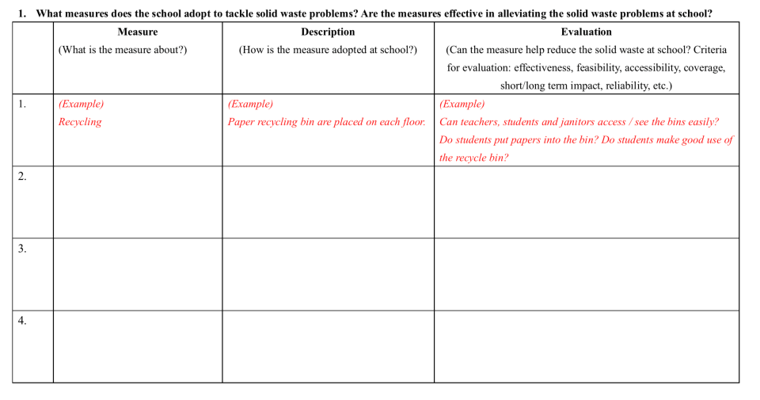
Effectiveness of Solid Waste Management at school
Reflection

Slide 12
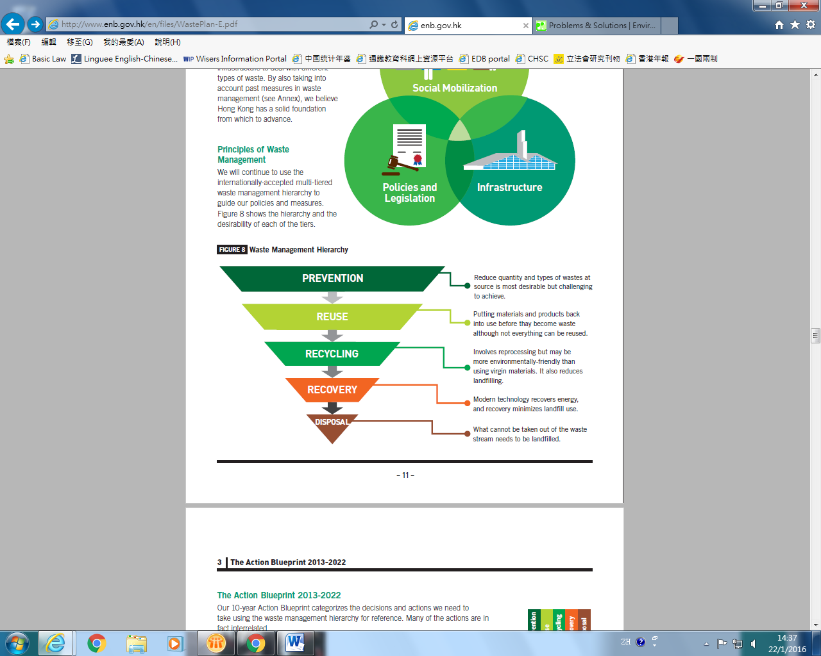
Waste Management Hierarchy廢物管理架構
Source:“Hong Kong Blueprint for Sustainable Use of Resources 2013-2022”.

Slide 13

Activity 2
Act
Concrete Experience
Facts (what happened?)
Materials: a bag of trash

Slide 14
Learning and teaching activity
Act
Concrete Experience
Facts (what happened?)
Activity on solid Waste management
Per-lesson Task
Take a photo of the waste you disposed of on the day before the lesson.
Share the photo in the lesson.

Slide 15
Learning and teaching activity
Reflection
Activity on solid Waste management
Class Discussion
Were these wastes necessary to be disposed of?
Waste | Reasons for disposing | Is it necessary to be disposed of? Is there any other function?

Slide 16
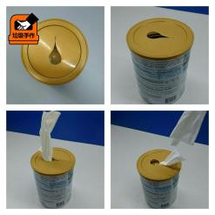
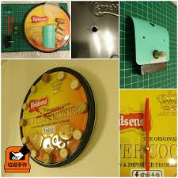
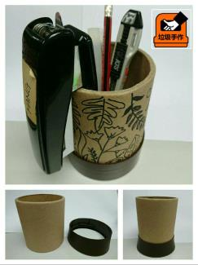
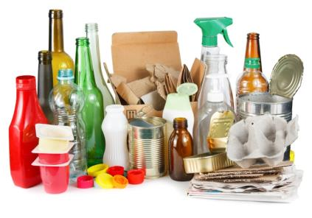
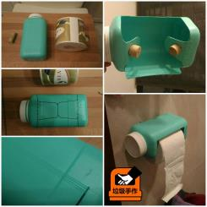
Any other functions of the wastes?
They are NOT wastes!
Source: Garbage Handmade HK (Facebook page)

Slide 17
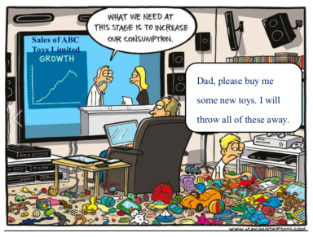
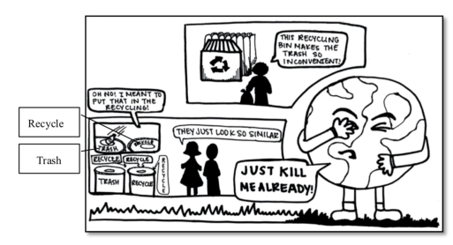
Reflection
Are you involved in the issue?
Reflection
Question for enquiry:
What are the causes of municipal solid waste in the society?
Source: https://zerowasteeurope.eu/2013/12/zero-waste-christmas-rethinking-consumption/
Source: https://zerowasteeurope.eu/2013/12/zero-waste-christmas-rethinking-consumption/

Slide 18
Follow up Discussion
Apply
Question for discussion:
What can WE do to help tackle the solid waste problems at school / in Hong Kong?
Personal level
School / community level
Societal level

Slide 19
Follow up Discussion
Apply
Question for discussion:
What are the causes of solid waste in Hong Kong?
Does Hong Kong adopt effective solid waste management measures to tackle solid waste problems?
What can different stakeholders do to tackle the solid waste problems in Hong Kong?
Personal level
School / community level
Societal level

Slide 20

Learning in LS Lessons
Connection between learning and lives
Learning becomes ‘real’ by experiencing and applicable in daily lives.
Opportunity for Reflection
By participating in concrete experiences with abstract concepts, this helps students better understand how the concepts learned can be applied.
Opportunity for Creativity
Students are encouraged to seek their own unique and most fulfilling solution to a hands-on task.

Slide 21
Learning objectives
Knowledge
To understand the current situation of municipal solid waste in Hong Kong.
To understand how the Hong Kong Government responds to the issue of municipal solid waste.
To evaluate the effectiveness of different solid waste management measures adopted in Hong Kong.

