Slide 1
Universal Design for Learning
通用設計學習
Long Story Shortz - Universal Design for Learning
https://www.youtube.com/watch?v=jTesLcx3VmE

Slide 2
What is Universal Design for Learning
Making Sense of UDL: https://www.youtube.com/watch?v=MOUdmzaZrc8
Universal Design for Learning is a set of principles for curriculum development that give all individuals equal opportunities to learn.
UDL provides a blueprint for creating instructional goals, methods, materials, and assessments that work for everyone--not a single, one-size-fits-all solution but rather flexible approaches that can be customized and adjusted for individual needs.

Slide 3
Why is UDL necessary?
Universal Design for Learning Overview https://www.youtube.com/watch?v=500dhPNZfHg (11’38”)
Individuals bring a huge variety of skills, needs, and interests to learning.
Neuroscience reveals that these differences are as varied and unique as our DNA or fingerprints.

Slide 4



Three primary brain networks
https://www.youtube.com/watch?v=FSHflViWRCQ
Recognition Networks
(The "what" of learning)
Representation: https://www.youtube.com/watch?v=ofOJqdDbUd8
Strategic Networks
(The “how" of learning)
Action and Representation: https://www.youtube.com/watch?v=s-EsS6Cbkj4
Affective Networks
(The "why" of learning)
Engagement :https://www.youtube.com/watch?v=nTwhcroMAaU

Slide 5
Three primary brain networks
Recognition Networks (What)
How we gather facts and categorize what we see, hear, and read. Identifying letters, words, or an author's style are recognition tasks.
Strategic Networks Planning and performing tasks (How)
How we organize and express our ideas. Writing an essay or solving a math problem are strategic tasks.
Affective Networks (Why)
How learners get engaged and stay motivated. How they are challenged, excited, or interested. These are affective dimensions.

Slide 6
Ways to do
The “what” of learning -- Multiple Means of Representation
Present information and content in different ways
The "how" of learning -- Multiple Means of Action and Expression
Differentiate the ways that students can express
what they know
The "why" of learning -- Multiple Means of Engagement
Stimulate interest and motivation for learning
UDL at a Glance: https://www.youtube.com/watch?v=bDvKnY0g6e4

Slide 7
UDL Guidelines Version 2.0
Principle I. (WHAT)
Provide Multiple Means of Representation
Guideline 1:
Provide options for perception
Guideline 2:
Provide options for language, mathematical
expressions, and symbols
Guideline 3:
Provide options for comprehension
(Copyright CAST, Inc. 20122012)

Slide 8
UDL Guidelines Version 2.0
Principle 2. (HOW)
Provide Multiple Means of Action and
Expression
Guideline 4 :
Provide options for physical action
Guideline 5:
Provide options for expression and communication
Guideline 6:
Provide options for executive functions
(Copyright CAST, Inc. 20122012)

Slide 9
UDL Guidelines Version 2.0
Principle 3. (WHY)
Provide Multiple Means of Engagement
Guideline 7:
Provide options for recruiting
Guideline 8:
Provide options for sustaining effort and
persistence
Guideline 9:
Provide options for self-regulation
(Copyright CAST, Inc. 20122012)

Slide 10
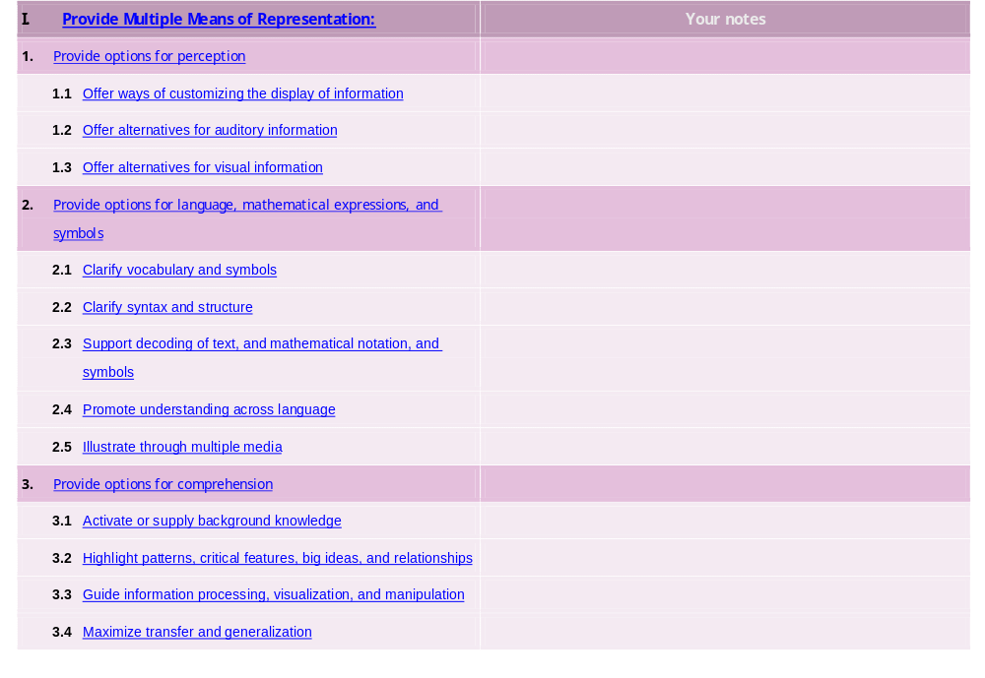
UDL Guidelines – Educator Checklist Version 2
© CAST 2011

Slide 11
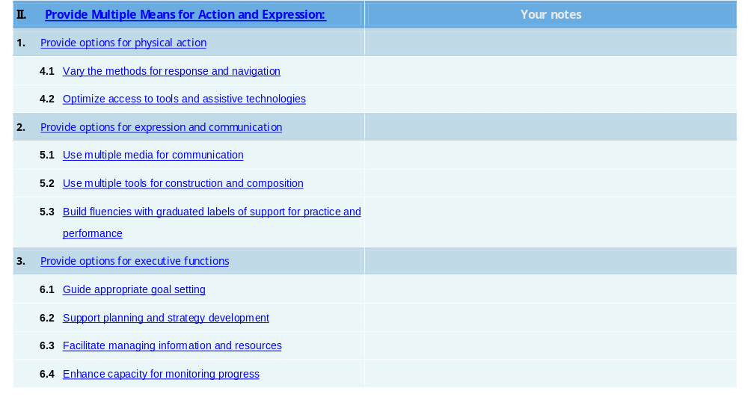

UDL Guidelines – Educator Checklist Version 2

Slide 12
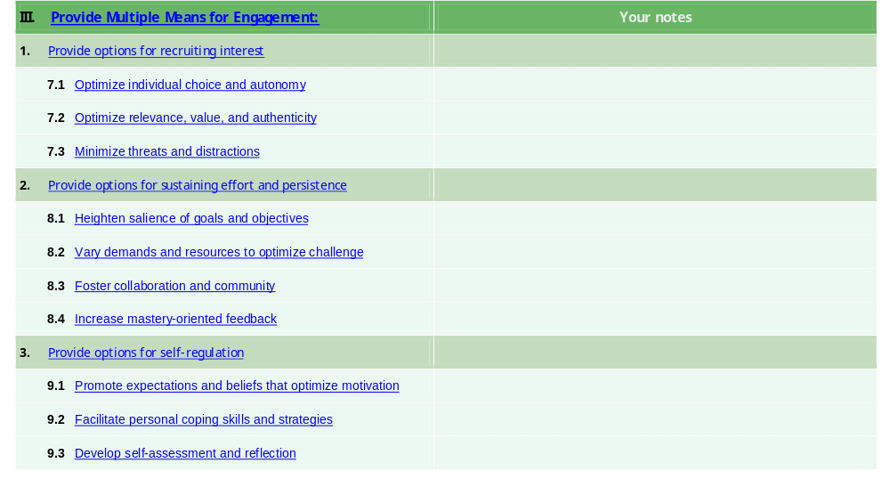
UDL Guidelines – Educator Checklist Version 2

Slide 13
The Implementation of UDL to Lesson Planning
Goal / Objective | Recognition Options |  |  | Expression & Action Options |  |  | Engagement Options
 | Under-standing | Language | Perception | Organization | Skills | Physical Action | Self-motivation | Maintaining Effort | Recruiting Interest

Slide 14
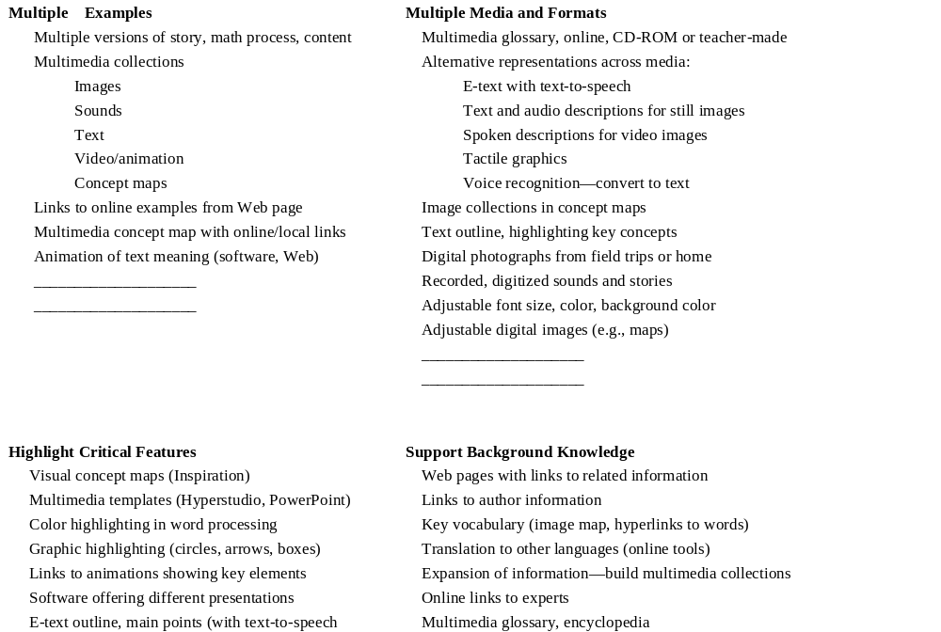
UDL Solutions: Recognition Networks

Slide 15
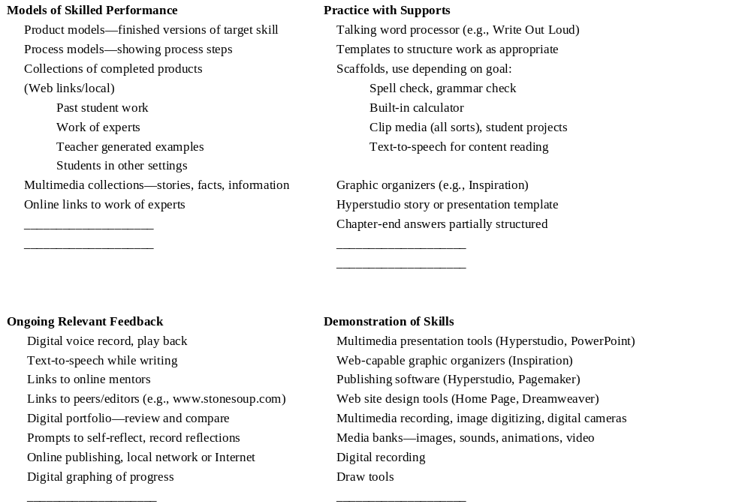
UDL Solutions: Strategic Networks

Slide 16
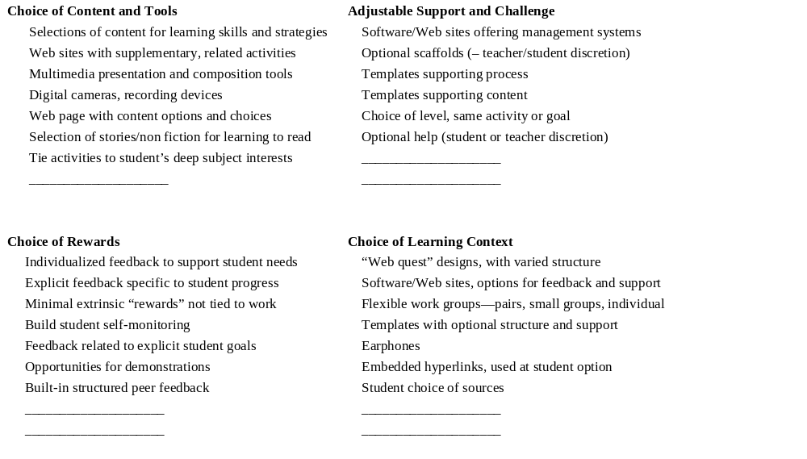
UDL Solutions: Affective Networks

Slide 17

Options
Options
OPTIONS
Options
Options
選擇
Options
Options

Slide 18
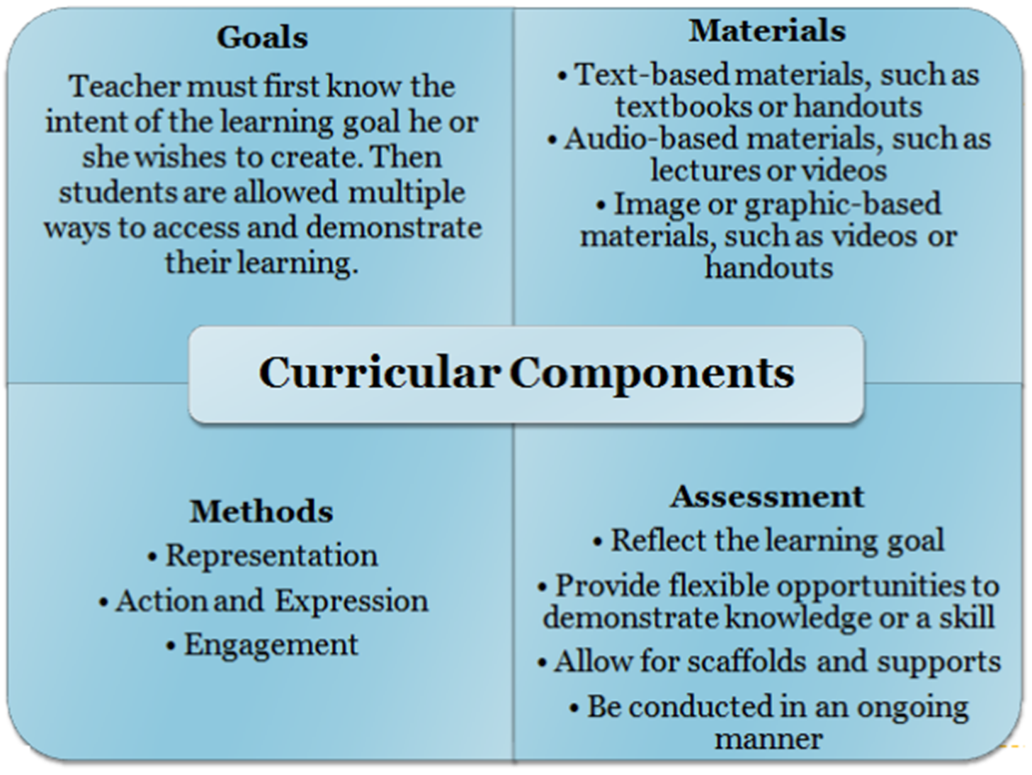
Curriculum Concerns and Lesson Planning

Slide 19

UDL: Reducing Barriers:
https://www.youtube.com/watch?v=xTShQyw3m80

Slide 20
Curriculum Pillar: Goals or Objectives
Example Goal:
The student will read three pieces of information articles to gain/learn the background knowledge, the concepts and to point out the key issues.
To present his/her what he/she has learnt in an oral presentation.
What barriers exist with this goal?

Slide 21
Options
Rewritten Goal:
The student will learn the subject matter and demonstrate the knowledge gained.
Removal of Barriers:
With this goal, the student can gain the background knowledge through a variety of means - video, digital text, and so on.
The student can present their gained knowledge in a variety of ways as well – power point, written report, oral presentation, chart or visual.
Student works in pairs or groups to find the key issues.

Slide 22
Curriculum Pillar: Materials
Example of Materials:
The material being used is a summary of doctorate thesis on the sustainability of land use and urban planning.
What barriers exist with this material?

Slide 23
Options
Removal of Barriers:
Light / easy reading version
Varied mode of materials to understand the concepts and the knowledge
Small bites of knowledge

Slide 24
Curriculum Pillar: Methods
Learning Styles and Barriers:
Often teachers prefer a lecture format or their preferred style of learning, students come in a variety of forms and styles with diverse methods of taking in information.
What barriers exist with this goal?

Slide 25
Options
Removal of Barriers:
When planning a lesson, this variation in method of taking information needs to be considered and incorporated within the lesson delivery.
Activities that involve all students’ styles of learning need to be incorporated into the curriculum.
Student-centered

Slide 26
Options
Removal of Barriers:
If lecture is used, a notetaking device should be provided for those that struggle with notetaking.
Further activities should be included to meet the needs of other styles of learning:
heterogeneous grouping vs. homogeneous grouping,
explorative activities vs. sit and get activities, to name but a few.

Slide 27
Curriculum Pillar: Assessment
The assessment should be designed in such a manner that students can express what they have learned about a certain topic.
A variety of assessments can be used for students to demonstrate the knowledge that has been gained on the assigned topic.
https://www.youtube.com/watch?v=AzRsqPqGlPw

Slide 28
Barriers to One Form of Assessment: Options
If an essay is required as the assessment tool, students who are unable to compose essays easily (struggle with organization, grammar, vocabulary, or physical difficulties) will struggle with the format and not be able to include their knowledge. The student might be best served through a multiple choice format of assessment.
If a chart is required to demonstrate knowledge gained, students who have difficulty organizing information will focus more on the completion of the task format rather than showing what they know.

Slide 29
Assessment (for Learning):
Precisely Defined Constructs
An important function of well-designed assessments is that they actually measure what they are intended to measure.
Test developers need to carefully examine what is to be tested and design items that offer the greatest opportunity for success within those constructs.
Just as universally designed architecture removes physical, sensory, and cognitive barriers to all types of people in public and private structures, universally designed assessments must remove all non-construct-oriented cognitive, sensory, emotional, and physical barriers.

Slide 30
Simple, Clear, and Intuitive Instructions and Procedures
Assessment instructions should be easy to understand, regardless of a student’s experience, knowledge, language skills, or current concentration level.
Directions and questions need to be in simple, clear, and understandable language.
Knowledge questions that are posed within complex language certainly invalidate the test if students cannot understand how they are expected to respond to a question.

Slide 31
Maximum Readability and Comprehensibility
A variety of guidelines exist to ensure that text is maximally readable and comprehensible.
These features go beyond what is measured by readability formulas.
Readability and comprehensibility are affected by many characteristics, including student background, sentence difficulty, organization of text, and others.
All of these features need to be considered in developing the text of assessments.

Slide 32
Plain language
Plain language is a concept now being highlighted in research on assessments.
Plain language has been defined as language that is straightforward and concise.
Strategies for editing text to produce plain language have been identified

Slide 33
Plain Language Editing Strategies
Strategy | Description
Reduce excessive length | Reduce wordiness and remove irrelevant material.
Use common words | Eliminate unusual or low frequency words and replace with common words (e.g., replace “utilize” with “use”).
Avoid ambiguous words | For example, “crane” should be avoided because it could be a bird or a piece of heavy machinery.
Avoid irregularly spelled words | Examples of irregularly spelled words are “trough” and “feign.”
Avoid proper names | Replace proper names with simple common names such as first names. (???)
Avoid inconsistent naming and graphic conventions | Avoid multiple names for the same concept. Be consistent in the use of typeface. (transformation: Concepts)
Avoid unclear signals about how to direct attention | Well-designed heading and graphic arrangement can convey information about the relative importance of information and order in which it should be considered.
Mark all questions | Give an obvious graphic signal (e.g., bullet, letter, number) to indicate separate questions.
Source: Brown (1999).

Slide 34
Maximum Legibility
Legibility is the physical appearance of text, the way that the shapes of letters and numbers enable people to read text easily. As delineated by Schriver, a leading document designer, text that is legible can be read “quickly, effortlessly, and with understanding” (see Resources).
Despite a great deal of research on what the characteristics of maximum legibility are, the personal opinions of editors about how they want text to look often prevail.
Bias results when tests contain physical features that interfere with a student’s focus on or understanding of the constructs that test items are intended to assess.
Dimensions can include contrast, type size, spacing, typeface, leading, justification, line length/width, blank space, graphs and tables, illustrations, and response formats.

Slide 35
Dimensions of Legibility and Characteristics of Maximum Legibility
Dimension | Maximum Legibility Characteristics
Contrast | Black type on matte pastel or off-white paper is most favorable for both legibility and eye strain.
Type Size | Large type sizes are most effective for young students who are learning to read, students with visual difficulties, and individuals with eye fatigue issues. The legal size for large print text is 14 point.
Spacing | The amount of space between each character can affect legibility. Spacing needs to be wide between both letters and words. Fixed-space fonts seem to be more legible for some readers than proportional-spaced fonts.
Leading | Leading, the amount of vertical space between lines of type, must be enough to avoid type that looks blurry and has a muddy look. The amount needed varies with type size (for example, 14-point type needs 3-6 points of leading).
Typeface | Standard typeface, using upper and lower case, is more readable than italic, slanted, small caps, or all caps.
Justification | Unjustified text (with staggered right margin) is easier to see and scan than justified text especially for poor readers.
Line Length | Optimal length is about 4 inches or 8 to 10 words per line. This length avoids reader fatigue and difficulty locating the beginning of the next line, which causes readers to lose their place.
Blank Space | A general rule is to allow text to occupy only about half of a page. Blank space anchors text on the paper and increases legibility.
Graphs and Tables | Symbols used on graphs need to be highly discriminable. Labels should be placed directly next to plot lines so that information can be found quickly and not require short-term memory.
Illustrations | When used, an illustration should be directly next to the question for which it is needed. Because illustrations create numerous visual and distraction challenges, and may interfere with the use of some accommodations (such as magnifiers), they should be used only when they contain information being assessed.
Response Formats | Response options should include larger circles (for bubble response tests), as well as multiple other forms of response.
Based on Thompson, Johnstone, and Thurlow (2002).

Slide 36
Unit / Lesson Planning
Four Pillars of Curriculum
goals/objectives,
materials,
methods
assessment
in combination with the three UDL networks:
recognition,
strategic,
affective.
(Sabia and Mandlawitz, 2010)

Slide 37
Considerations for Lesson Planning Involving
UDL Brain Networks and the Four Pillars of Curriculum
Lesson Plan Description:
Four Pillars of Curriculum | UDL Brain Networks
Goals/Objectives: | Recognition:
 | Strategic:
 | Affective:
Materials: | Recognition:
 | Strategic:
 | Affective:
Methods: | Recognition:
 | Strategic:
 | Affective:
Assessment: | Recognition:
 | Strategic:
 | Affective:

Slide 38
教學策略: 適宜教學
1 教學內容：學生可以不同的角度學習同一的課題；
2 學生興趣：教學活動的設計要配合學生的興趣和過往經歷；
3 學習進度：教師可因應學生的差異兼容不同的學習進度；
4 教學次序：把學習內容及活動細分為一系列循序漸進的小步驟
。若學生在某個步驟遇到困難，教師可將該步驟再
分 割成更小的步學習程度：學生從各自不同的基礎
上習同一課題概念；子，讓學生更有效地學習；
5 學習程度：學生從各自不同的基礎上，學習同一課題概念；

Slide 39
教學策略: 適宜教學
6 溝通方式：教師可利用視覺、聽覺、觸覺等不同媒介，讓學生
運用不同感官去感知事物。教師可採用不同形式的
教學媒介，例如：圖像、資訊科技、符號、言語等
等，促進學生對知識及技能的理解，加強思維及記
憶力的發展，也可以提高學習興趣和增強專注力；
7 學生回應：學生以不同的方式展示學習成果；
8 內容結構：教學內容分為有系統的細項或概念相關的章節，
可以是專題或綜合性的題材；
9 教學時間：可用一半時間教學，另一半時間讓學生進行鞏固學
習的活動；甚或給予額外時間支援；

Slide 40
教學策略: 適宜教學
10 教學方式：可以是講說、探索或論述。
11 學習方式：可以是聆聽、探究或解難；及
12 學生組合：學生可以不同的組合方式學習，例如雙人
、小組、全班、科組或全校等

